Slide 1
Systematic Analysis of Variant Effect Maps
BCB330 Final Presentation
Bilin Nong
Supervisors: Jochen Weile & Fritz Roth
@ the Roth Lab

Slide 2
Outlines
Introduction
MAVEs: a proactive approach
New pipelines vs. Old pipelines
Objectives
Results
SUMO1
CALM1

Slide 3
Background
Interpretation of clinical variants
ACMG guidelines (P, LP, B, LB, VUS) → classify variant effect
Majority of clinical variants → VUS (Variant of uncertain significance)
Types of evidence
Laboratory Assays
Computational Predictors
Notes:
Linking genotype to phenotype is a complex problem.

Slide 4
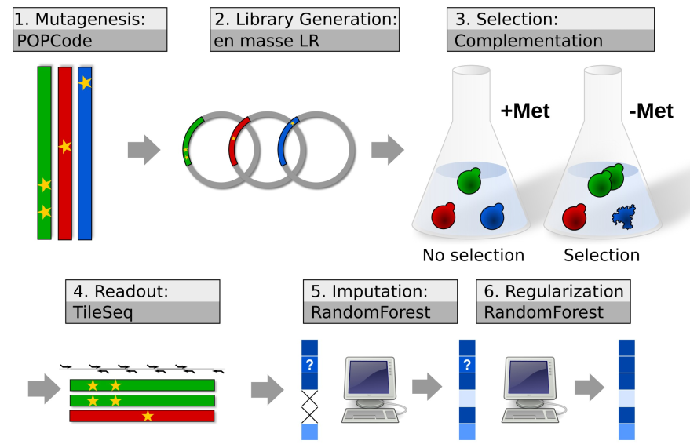
Multiplex Assays of Variant Effect (MAVEs)
Thank Jochen for making the graph!
Notes:
POPCode Mutagenesis -> codon randomized variant libraries
Subsequently, transfer the entry libraries to expression vector to enable yeast expression
Then, we used complementation assays for the selection
Tileseq/barseq strategy can be used for reading out the effects of selection
Imputation/ regularization can be use downstream computational analysis

Slide 5
New & Old version of MAVEs pipelines
Old version of MAVEs pipelines vs. New version of MAVEs pipelines
Old – collapsing equivalent codon changes → calculate the score from combined aa changes (filter)
New – calculate score on codon changes separately -> filter -> merge
Sacrifice Power for accuracy, but may have more noise potentially

Slide 6
Objectives
1. Re-process the raw data underlying existing variant effect maps with the latest versions of their respective analysis pipelines.
2. Evaluate the performance of different versions of MAVE pipelines.

Slide 7
SUMO1
QC Results
Correlation between New Scores & Old Scores
Correlation between Fitness Scores & VARITY Scores
Conclusion

Slide 8
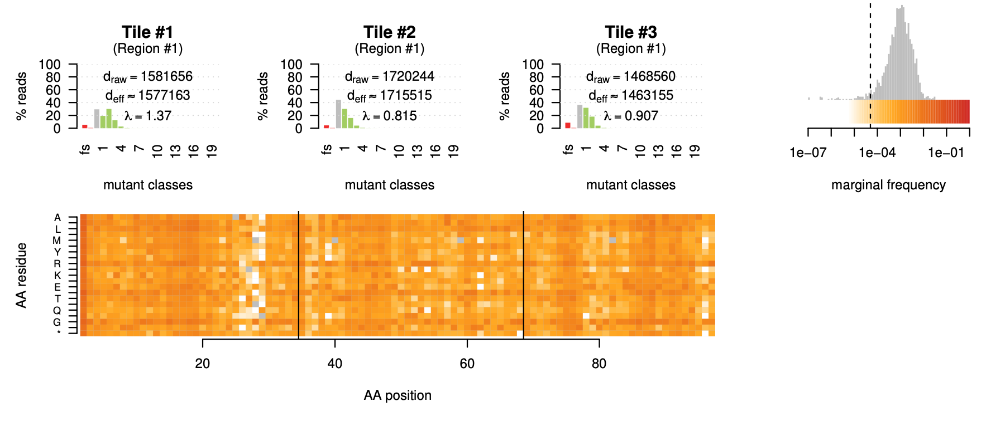
Good Overall Coverage
Filtered out
Possible reason: low efficiency of mutagenesis
Notes:
Low coverage – mutagenesis lower efficiency

Slide 9
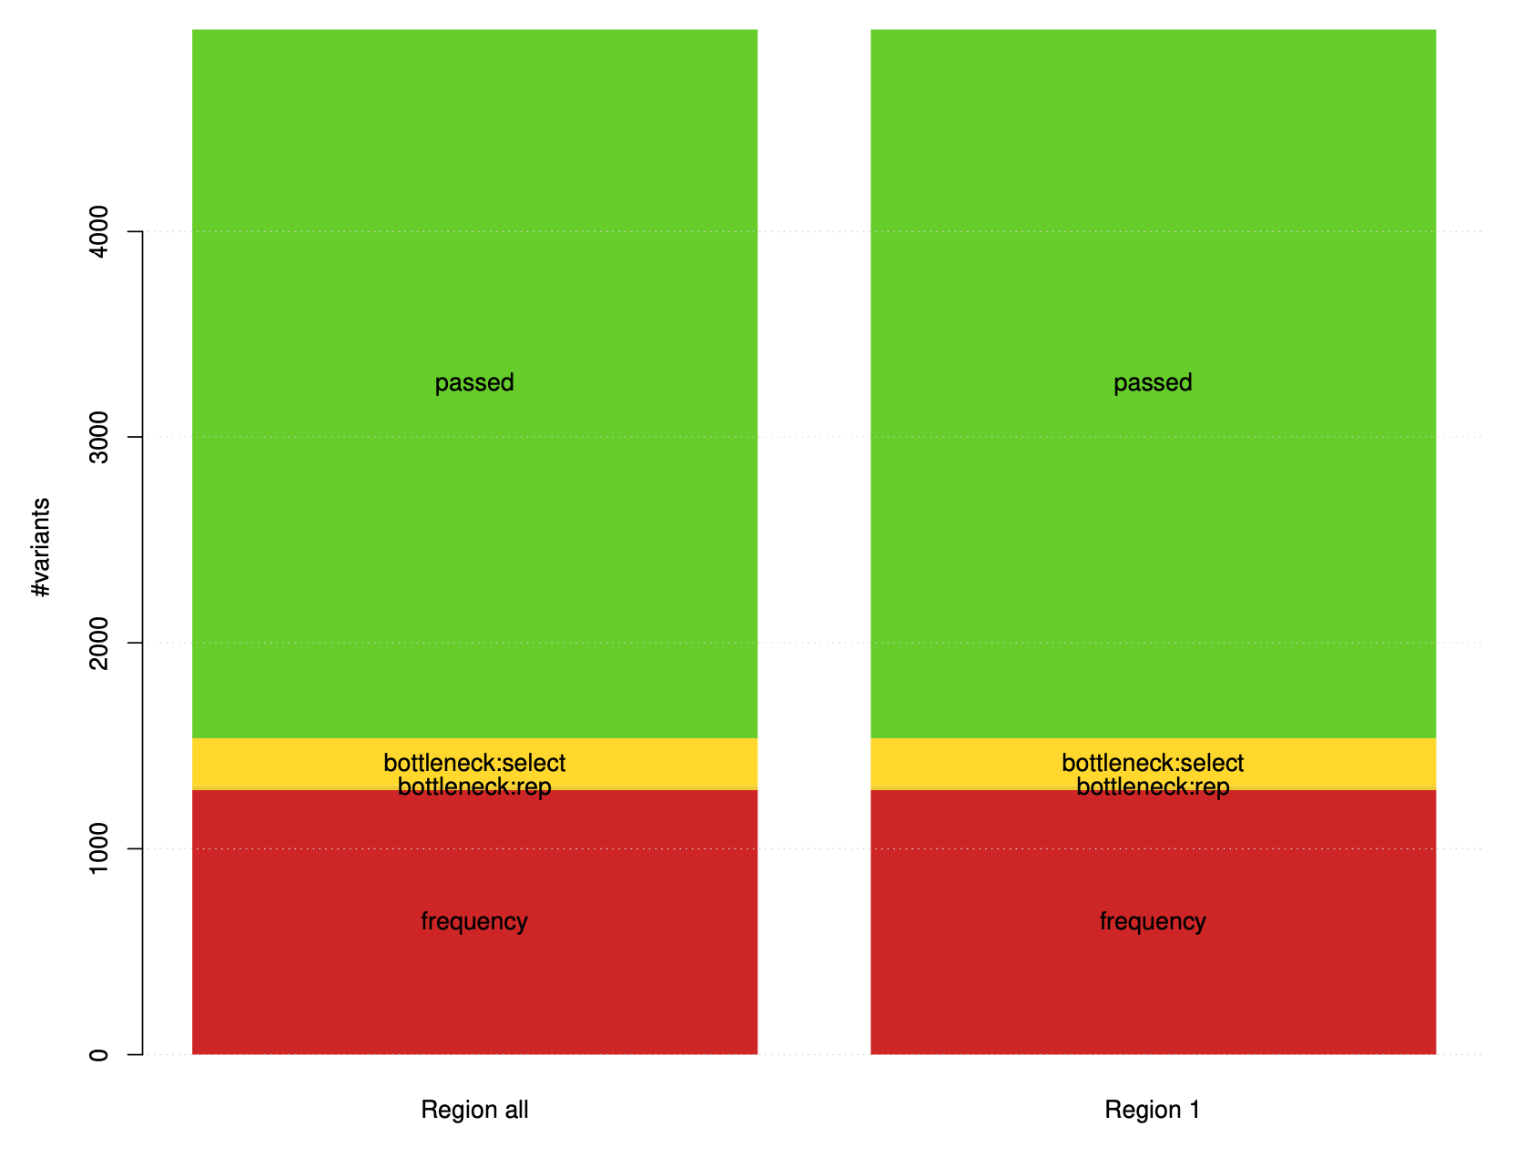
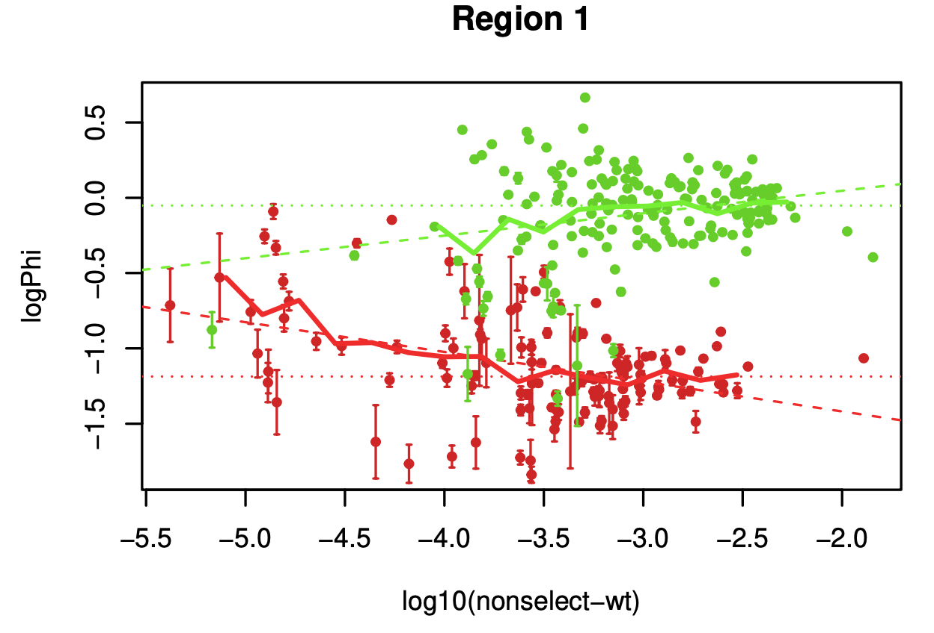

1/3 of SUMO1 variants are subject to Frequency Filter
Sequencing depth
~ -4.3
Minimum read count:
$${10}^{6}×{10}^{−4.3} ≈100$$
Notes:
Good separation
Freq = , -4.3 , line

Slide 10
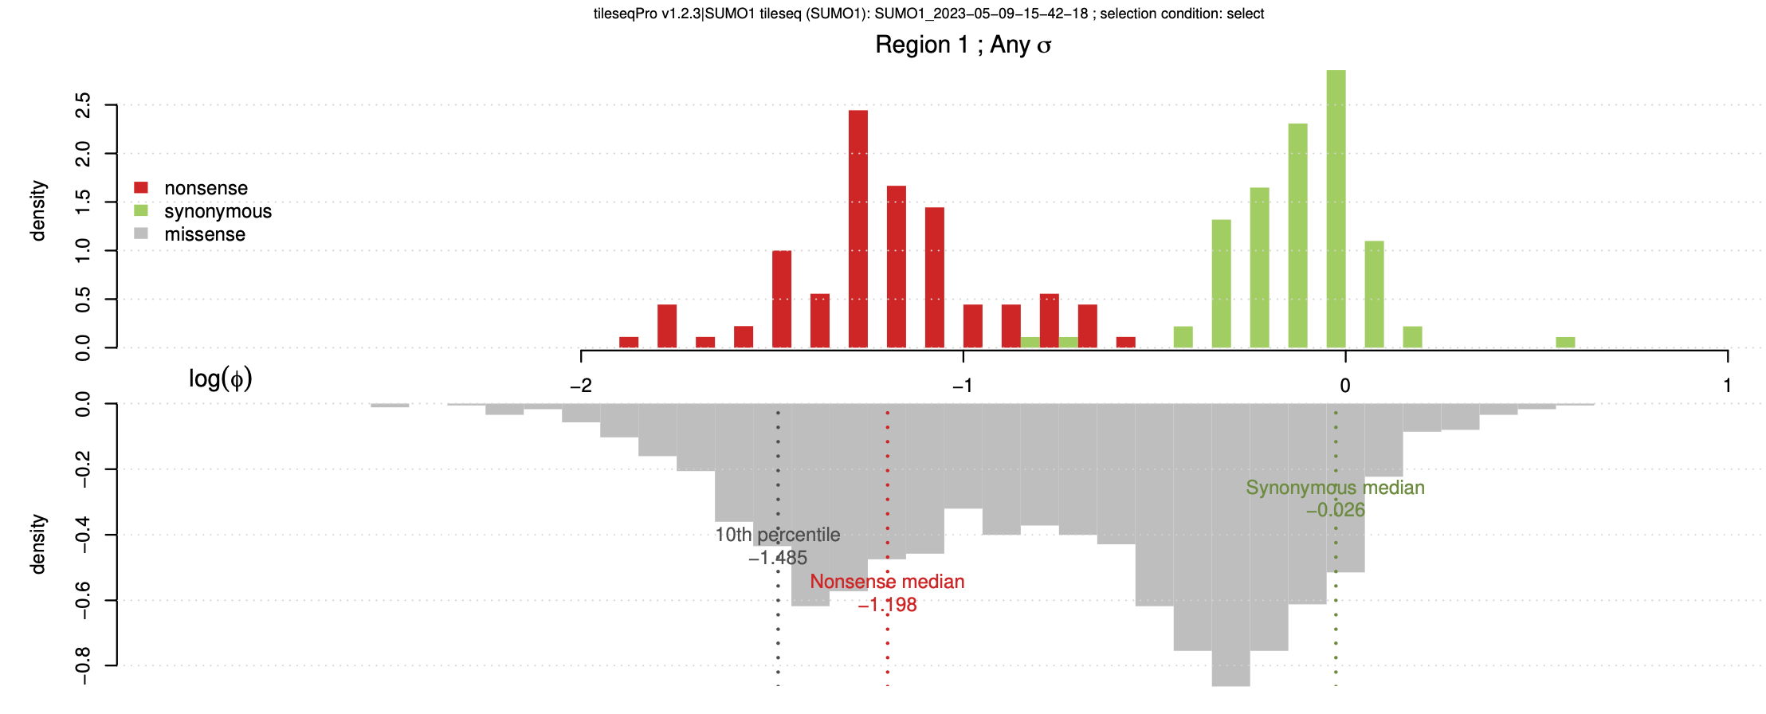
Good separation between nonsense & Synonymous Variants
Nonsense mode has higher enrichment values than the missense variants
Filtering Issues/ Measurement Error
Notes:
Filtering issue, measurement error

Slide 11
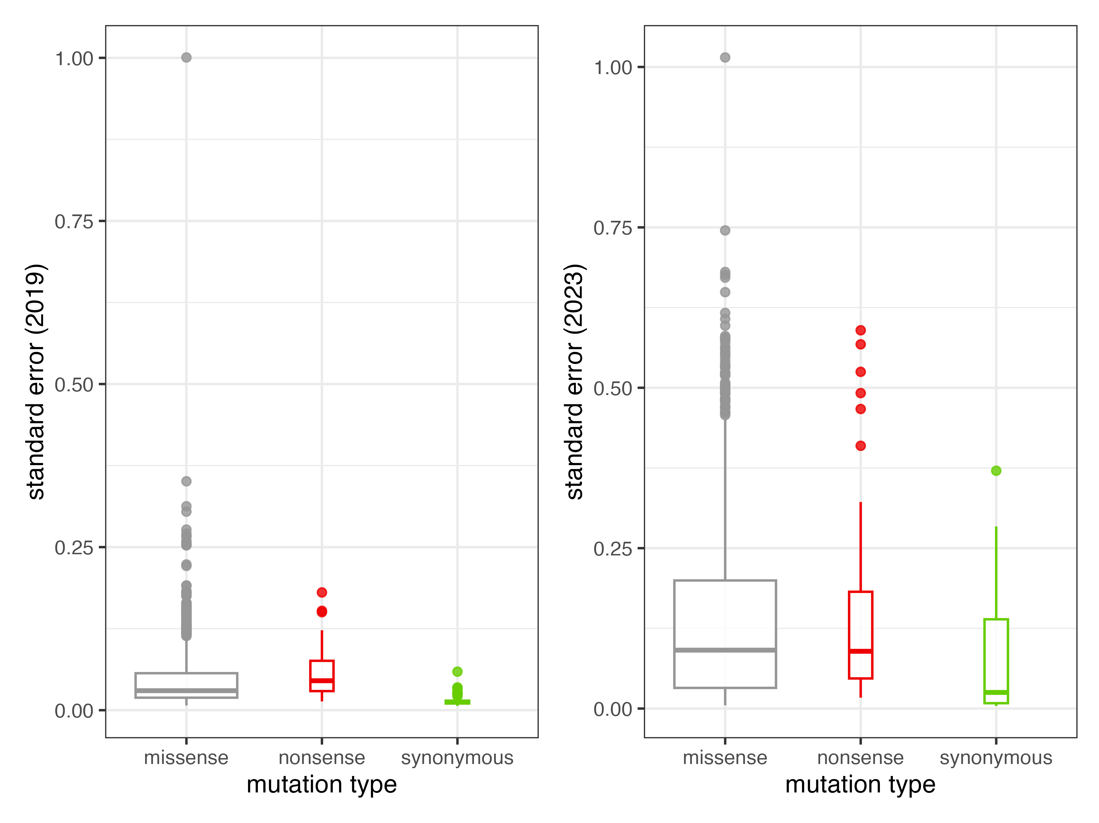
2023 version fitness Scores has higher SE than the Old Scores
Possible Reasons:
Bootstrapping in new pipelines
More accurate & Pessimistic error Regularization
Notes:
Bootstrapping in new – more accurate , more pessimistic error regularization

Slide 12
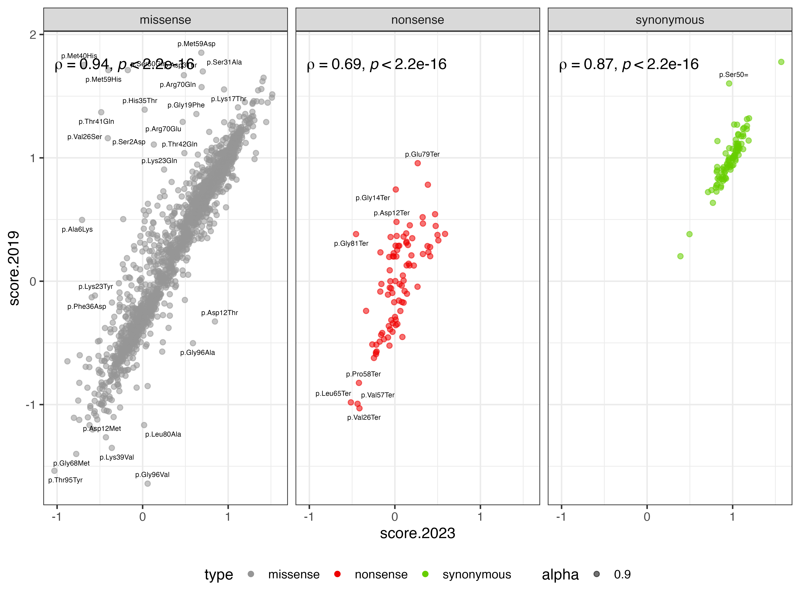
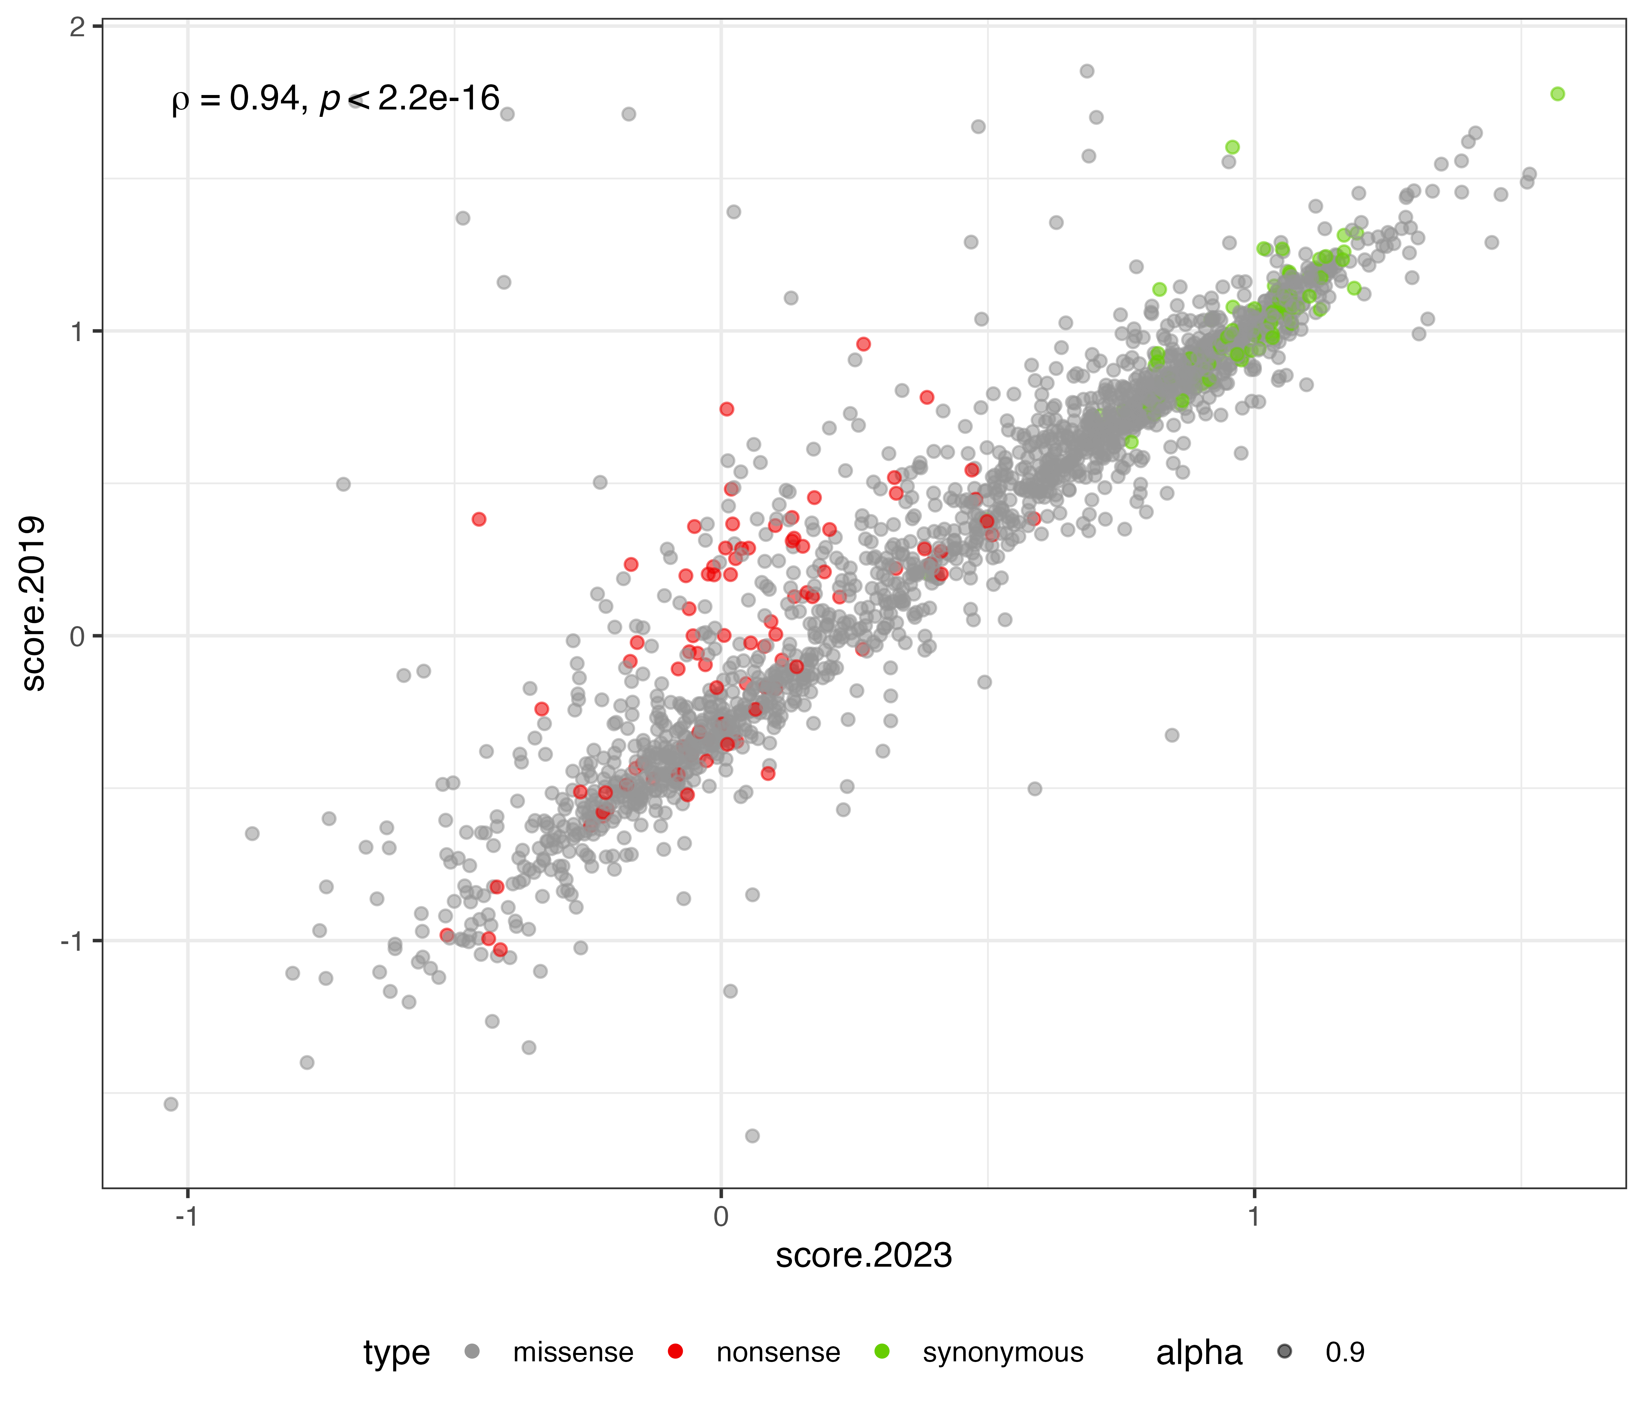
High Correlation between New & Old Scores
Lower correlation for nonsense variants
Notes:
Less correlation for nonsense – higher se
Few codon changes -- filter out , less information

Slide 13
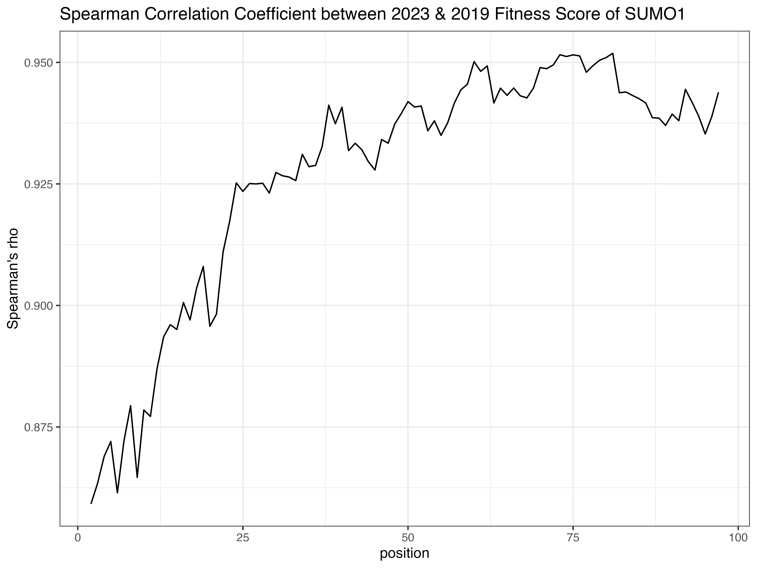
Disorder Region of SUMO1 (synonymous like)
Notes:
First 20 – disorder , score – high, synonymous like

Slide 14
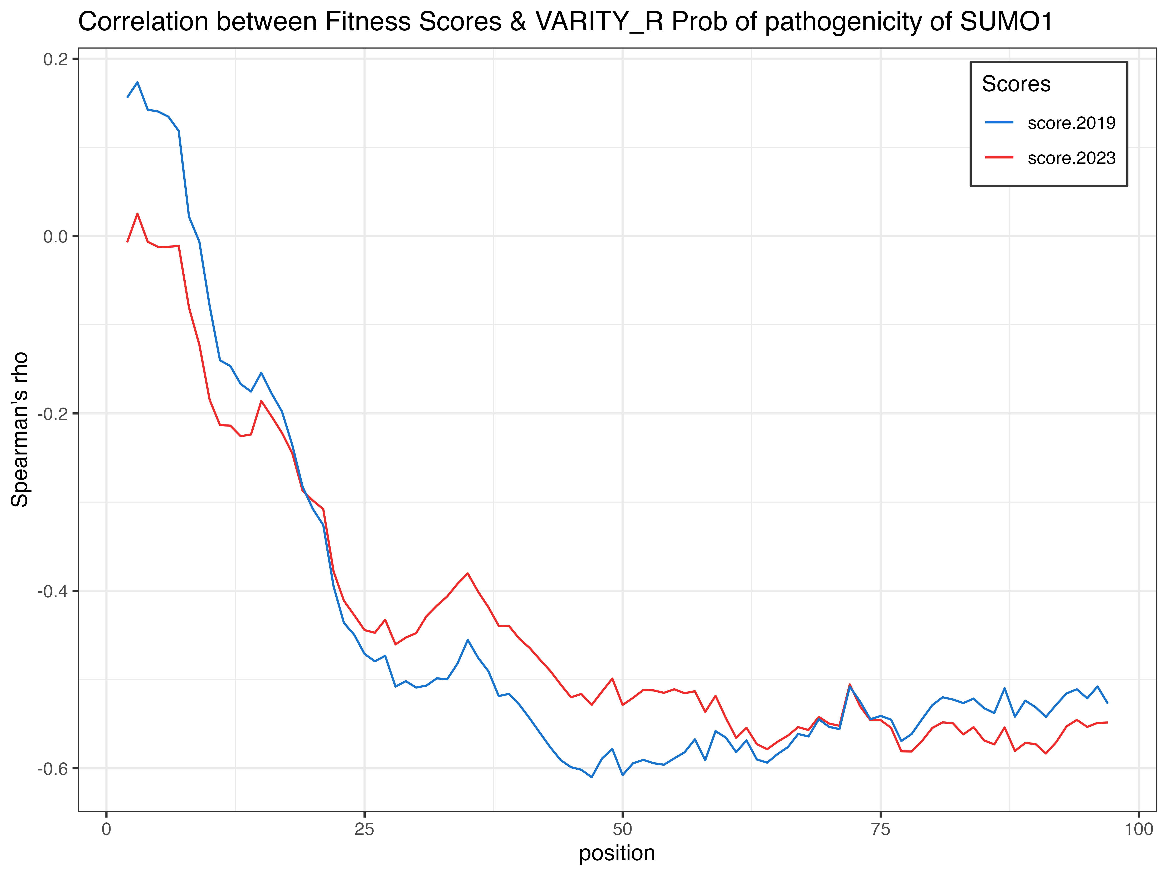
Anti-Correlation between fitness scores and VARITY_R Score
VARITY: produce a probability of pathogenicity (scale oppositely to fitness)

Slide 15
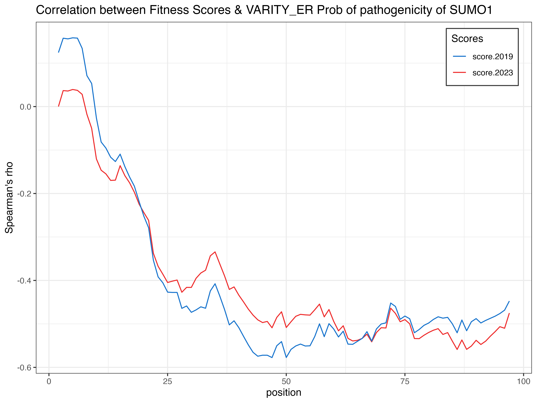
Anti-Correlation between fitness scores and VARITY_ER Score
Notes:
Anti correlation –better

Slide 16
SUMO1: conclusion
The New pipelines & Old pipelines performed similar
The New pipelines used more info on generating the error estimates -> Accurate Error Estimation

Slide 17
CALM1
QC Results
Correlation between New Scores & Old Scores
PRC
LLR of Pathogenicity
Conclusion

Slide 18
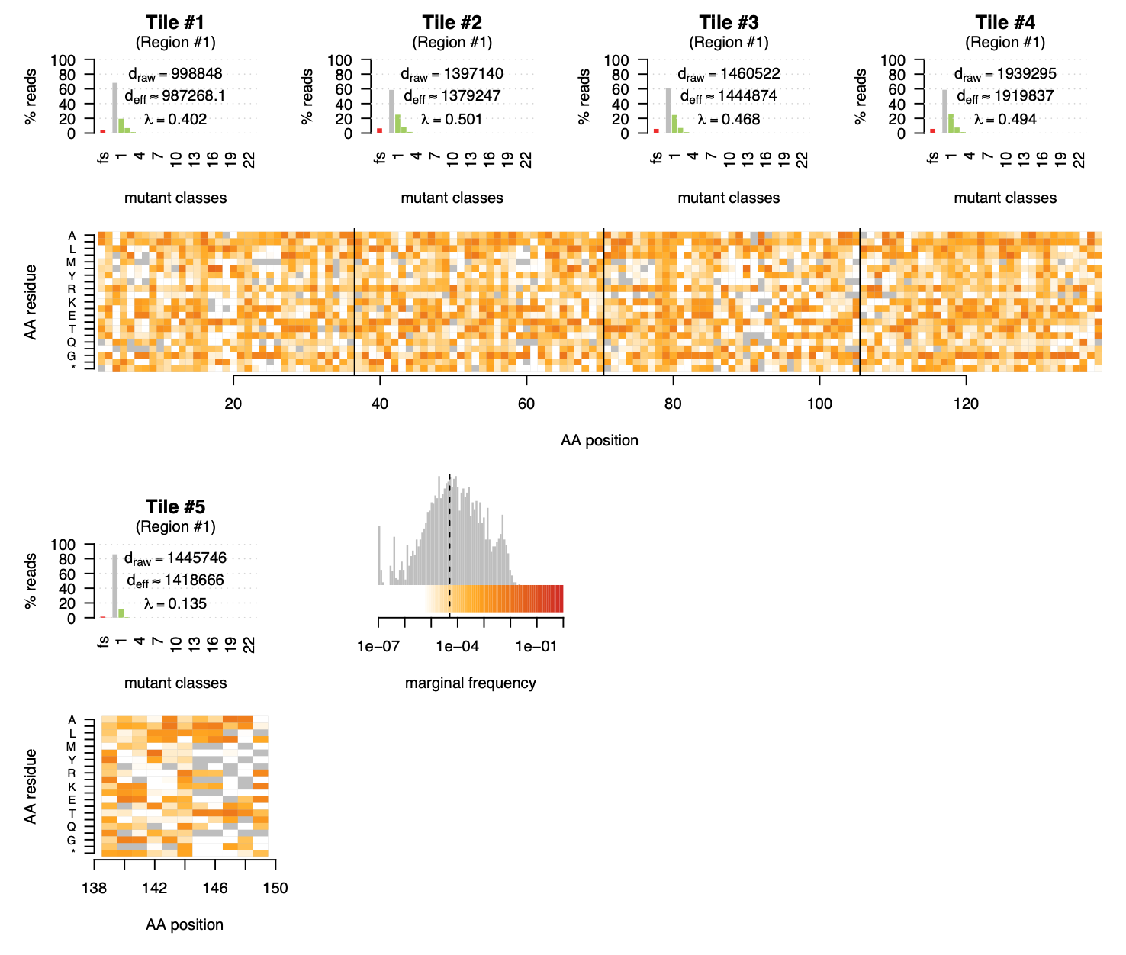
Low Coverage
Filtered out
Possible Reason: Low efficiency of mutagenesis

Slide 19
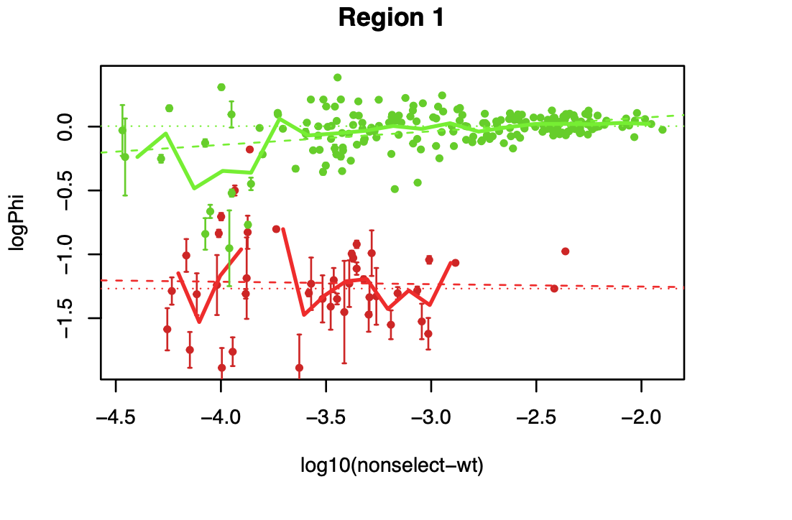
~ 2/3 of Variants were filtered out
~ -4.3
Minimum read count:
$${10}^{6}×{10}^{−4.3} ≈100$$

Slide 20
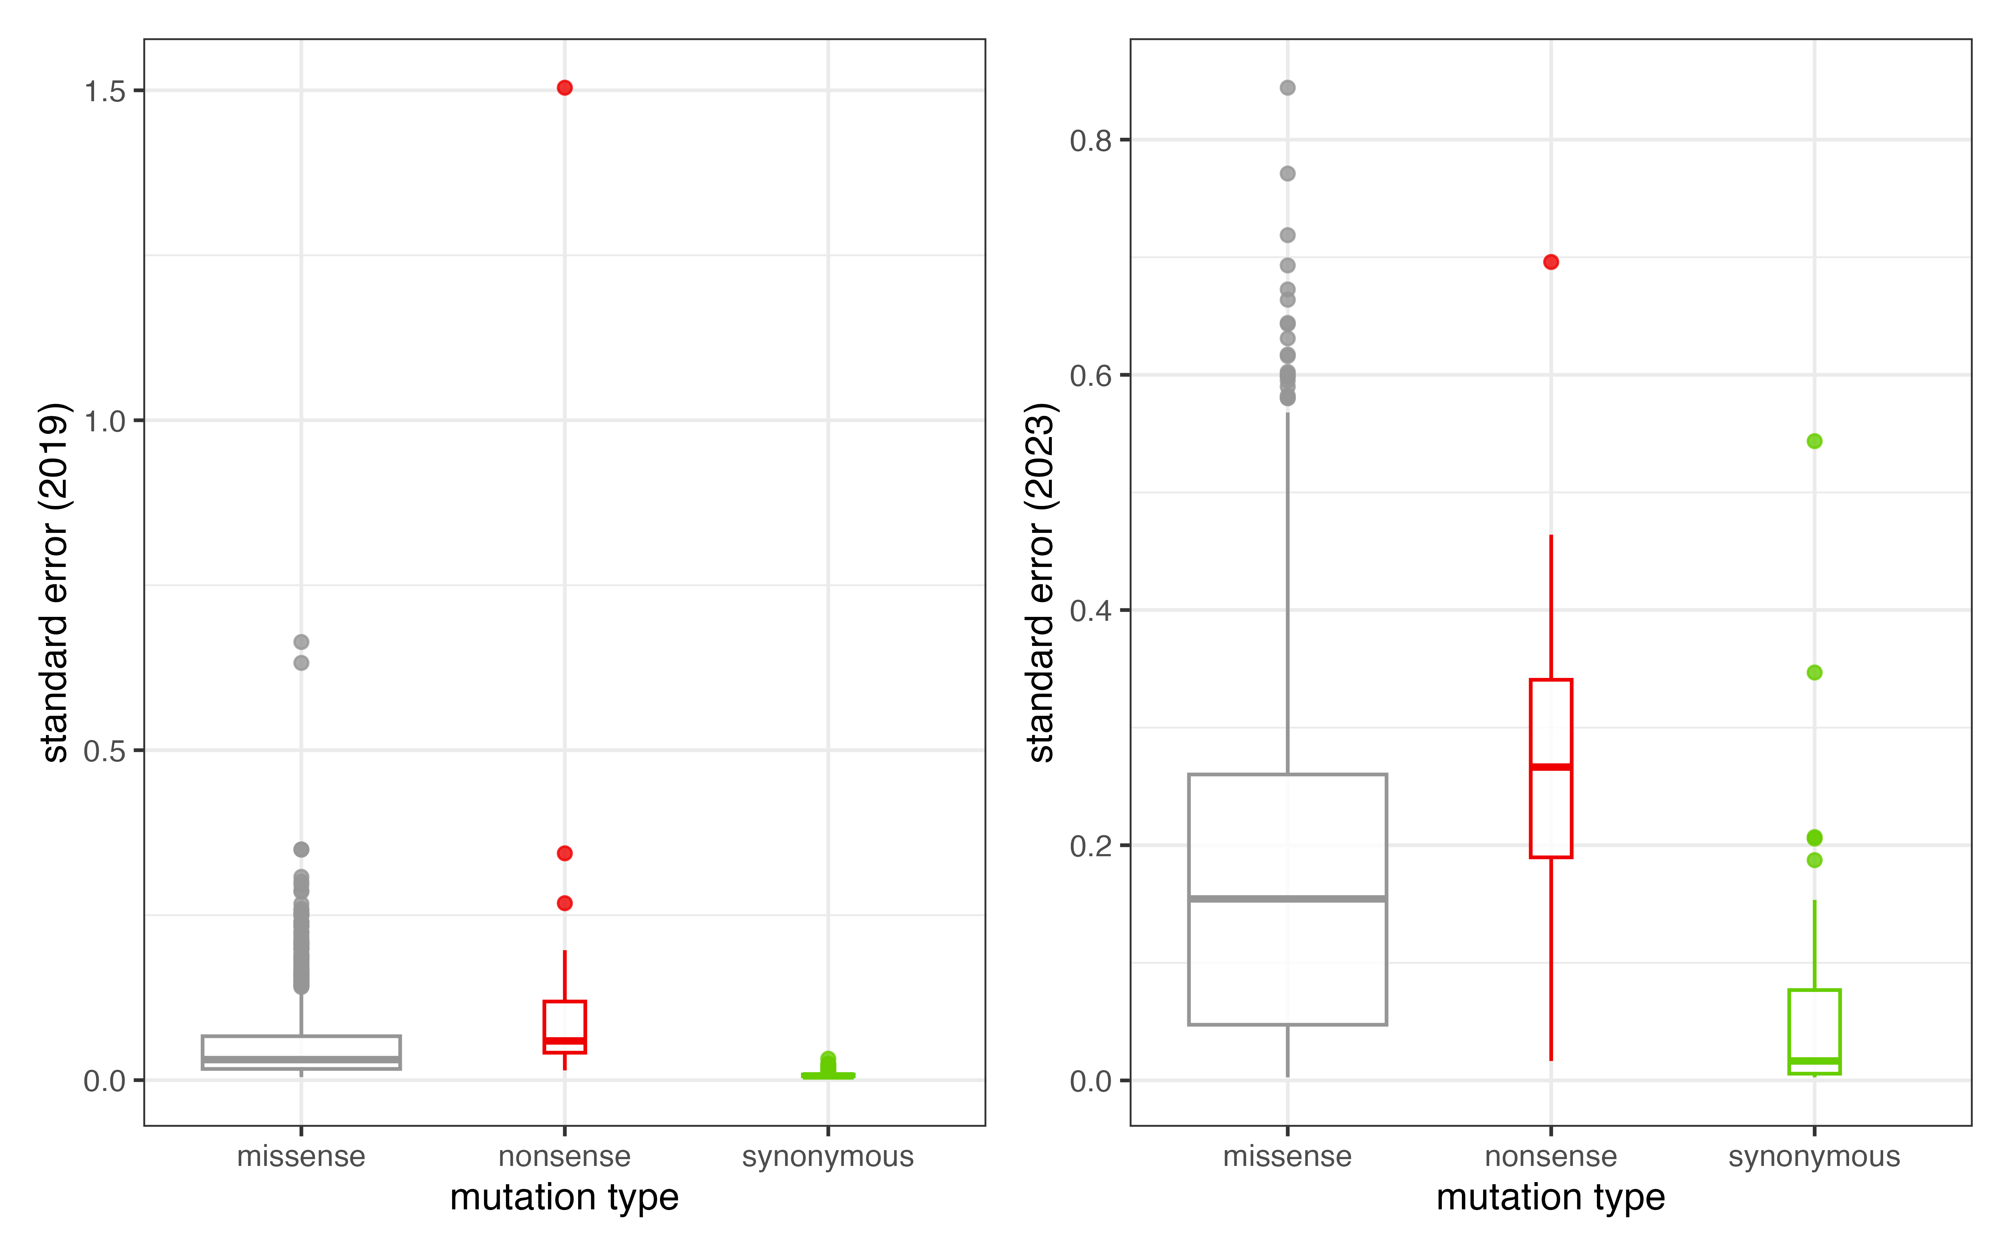
2023 version fitness Scores has higher SE than the Old Scores

Slide 21
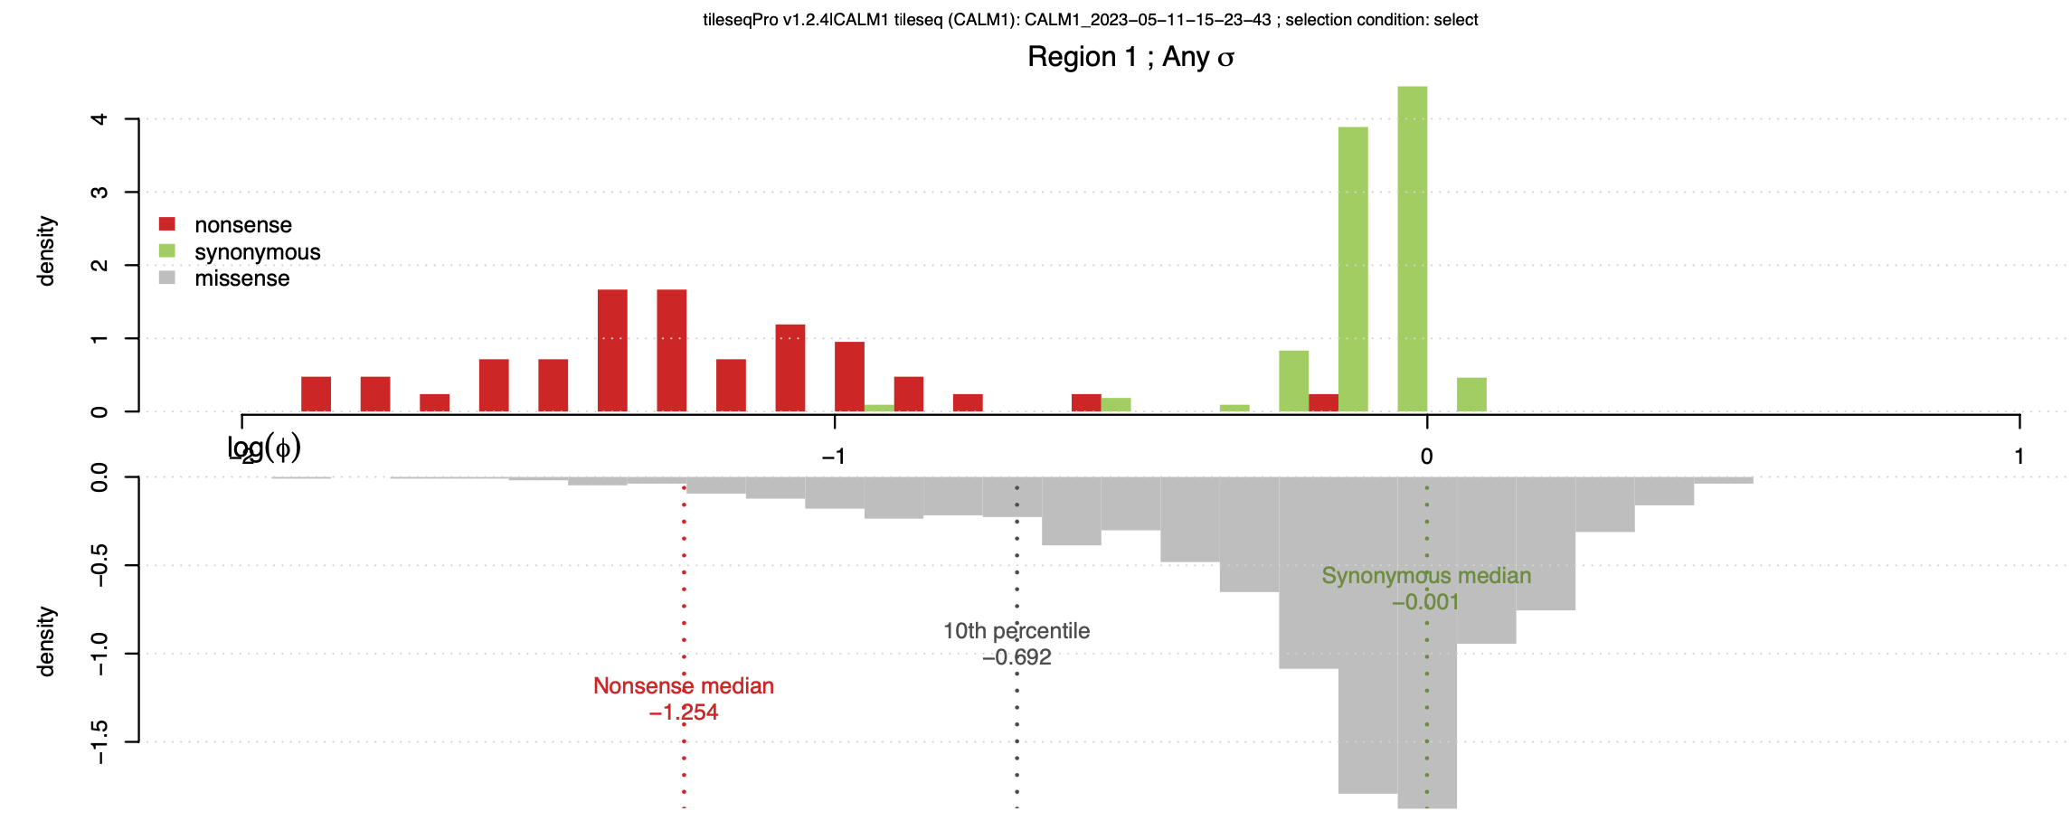
Good separation between the nonsense & synonymous Variants
One mode in missense variants – not so damaging
Notes:
Filter – good separation, one mode in missense (not damaging )

Slide 22
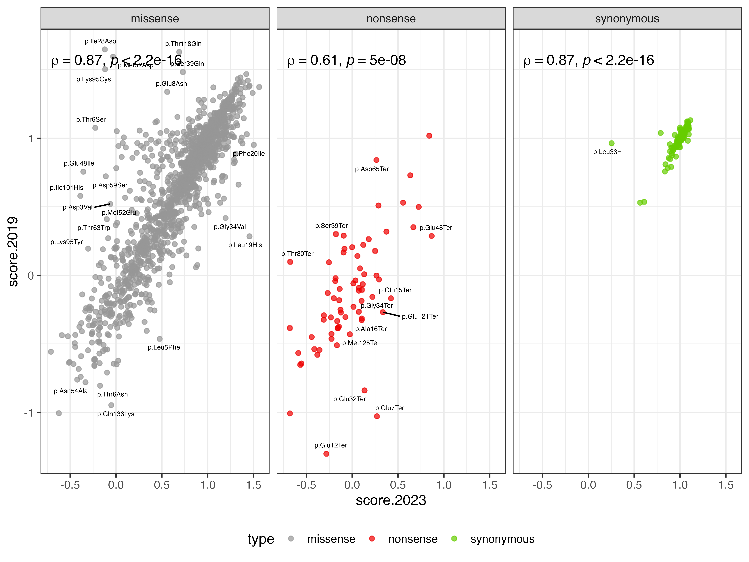
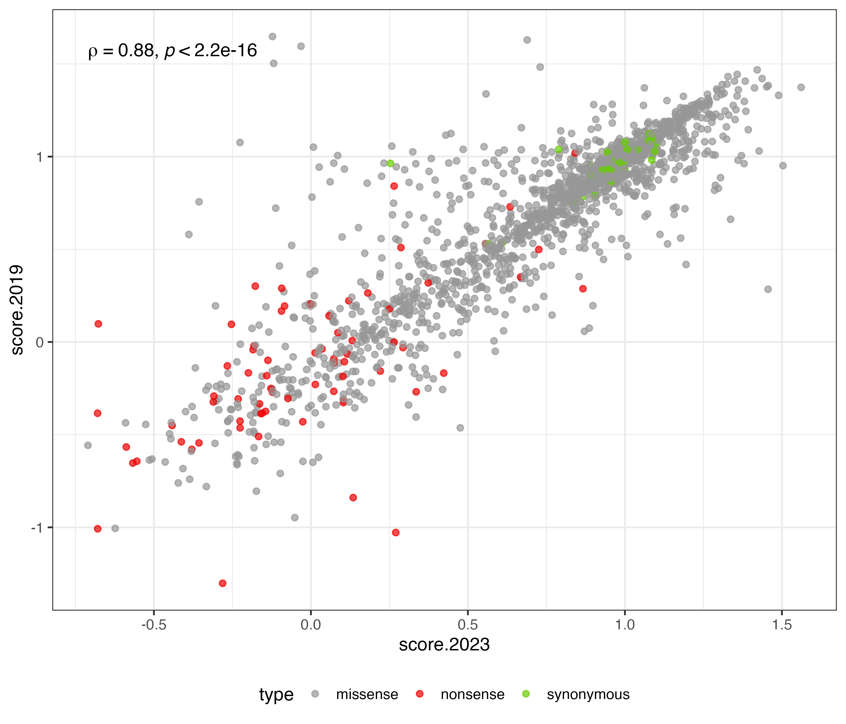
Good Correlation between New & Old Scores

Slide 23
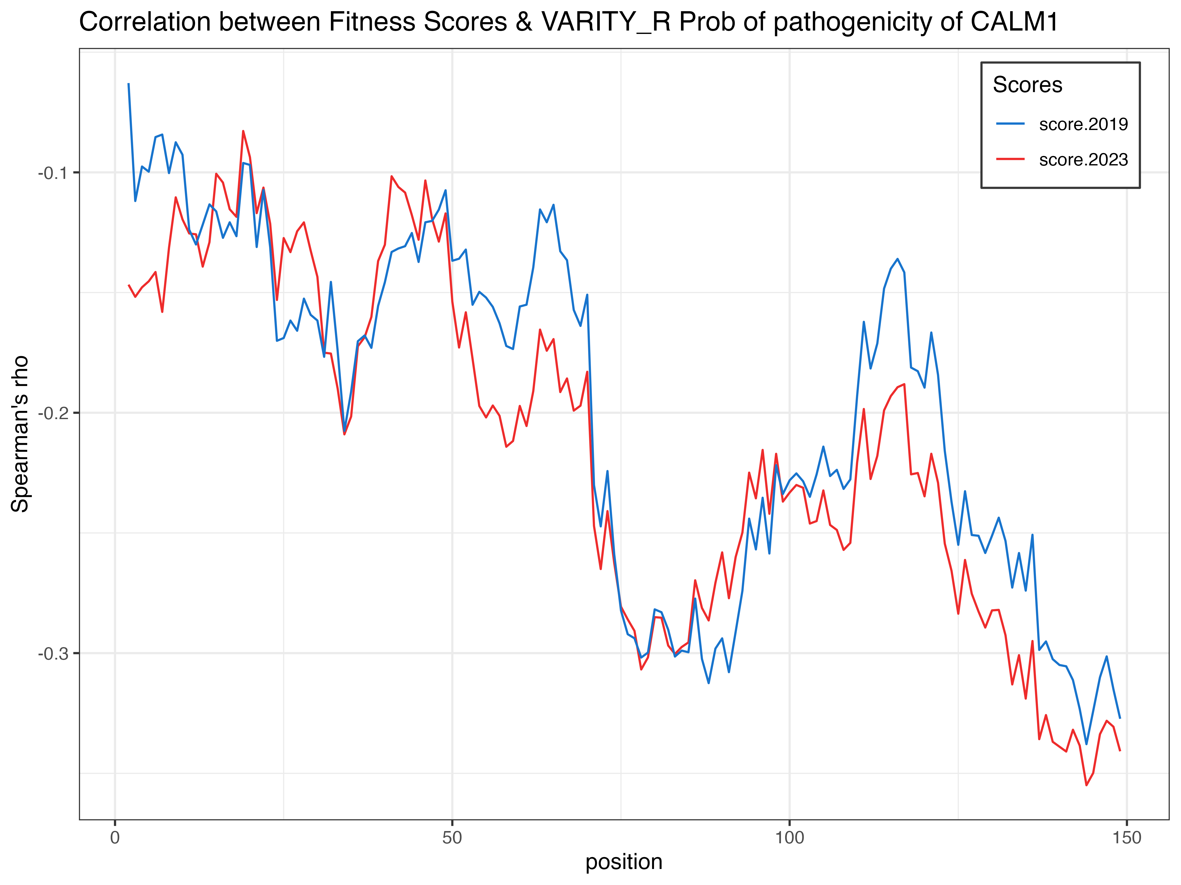
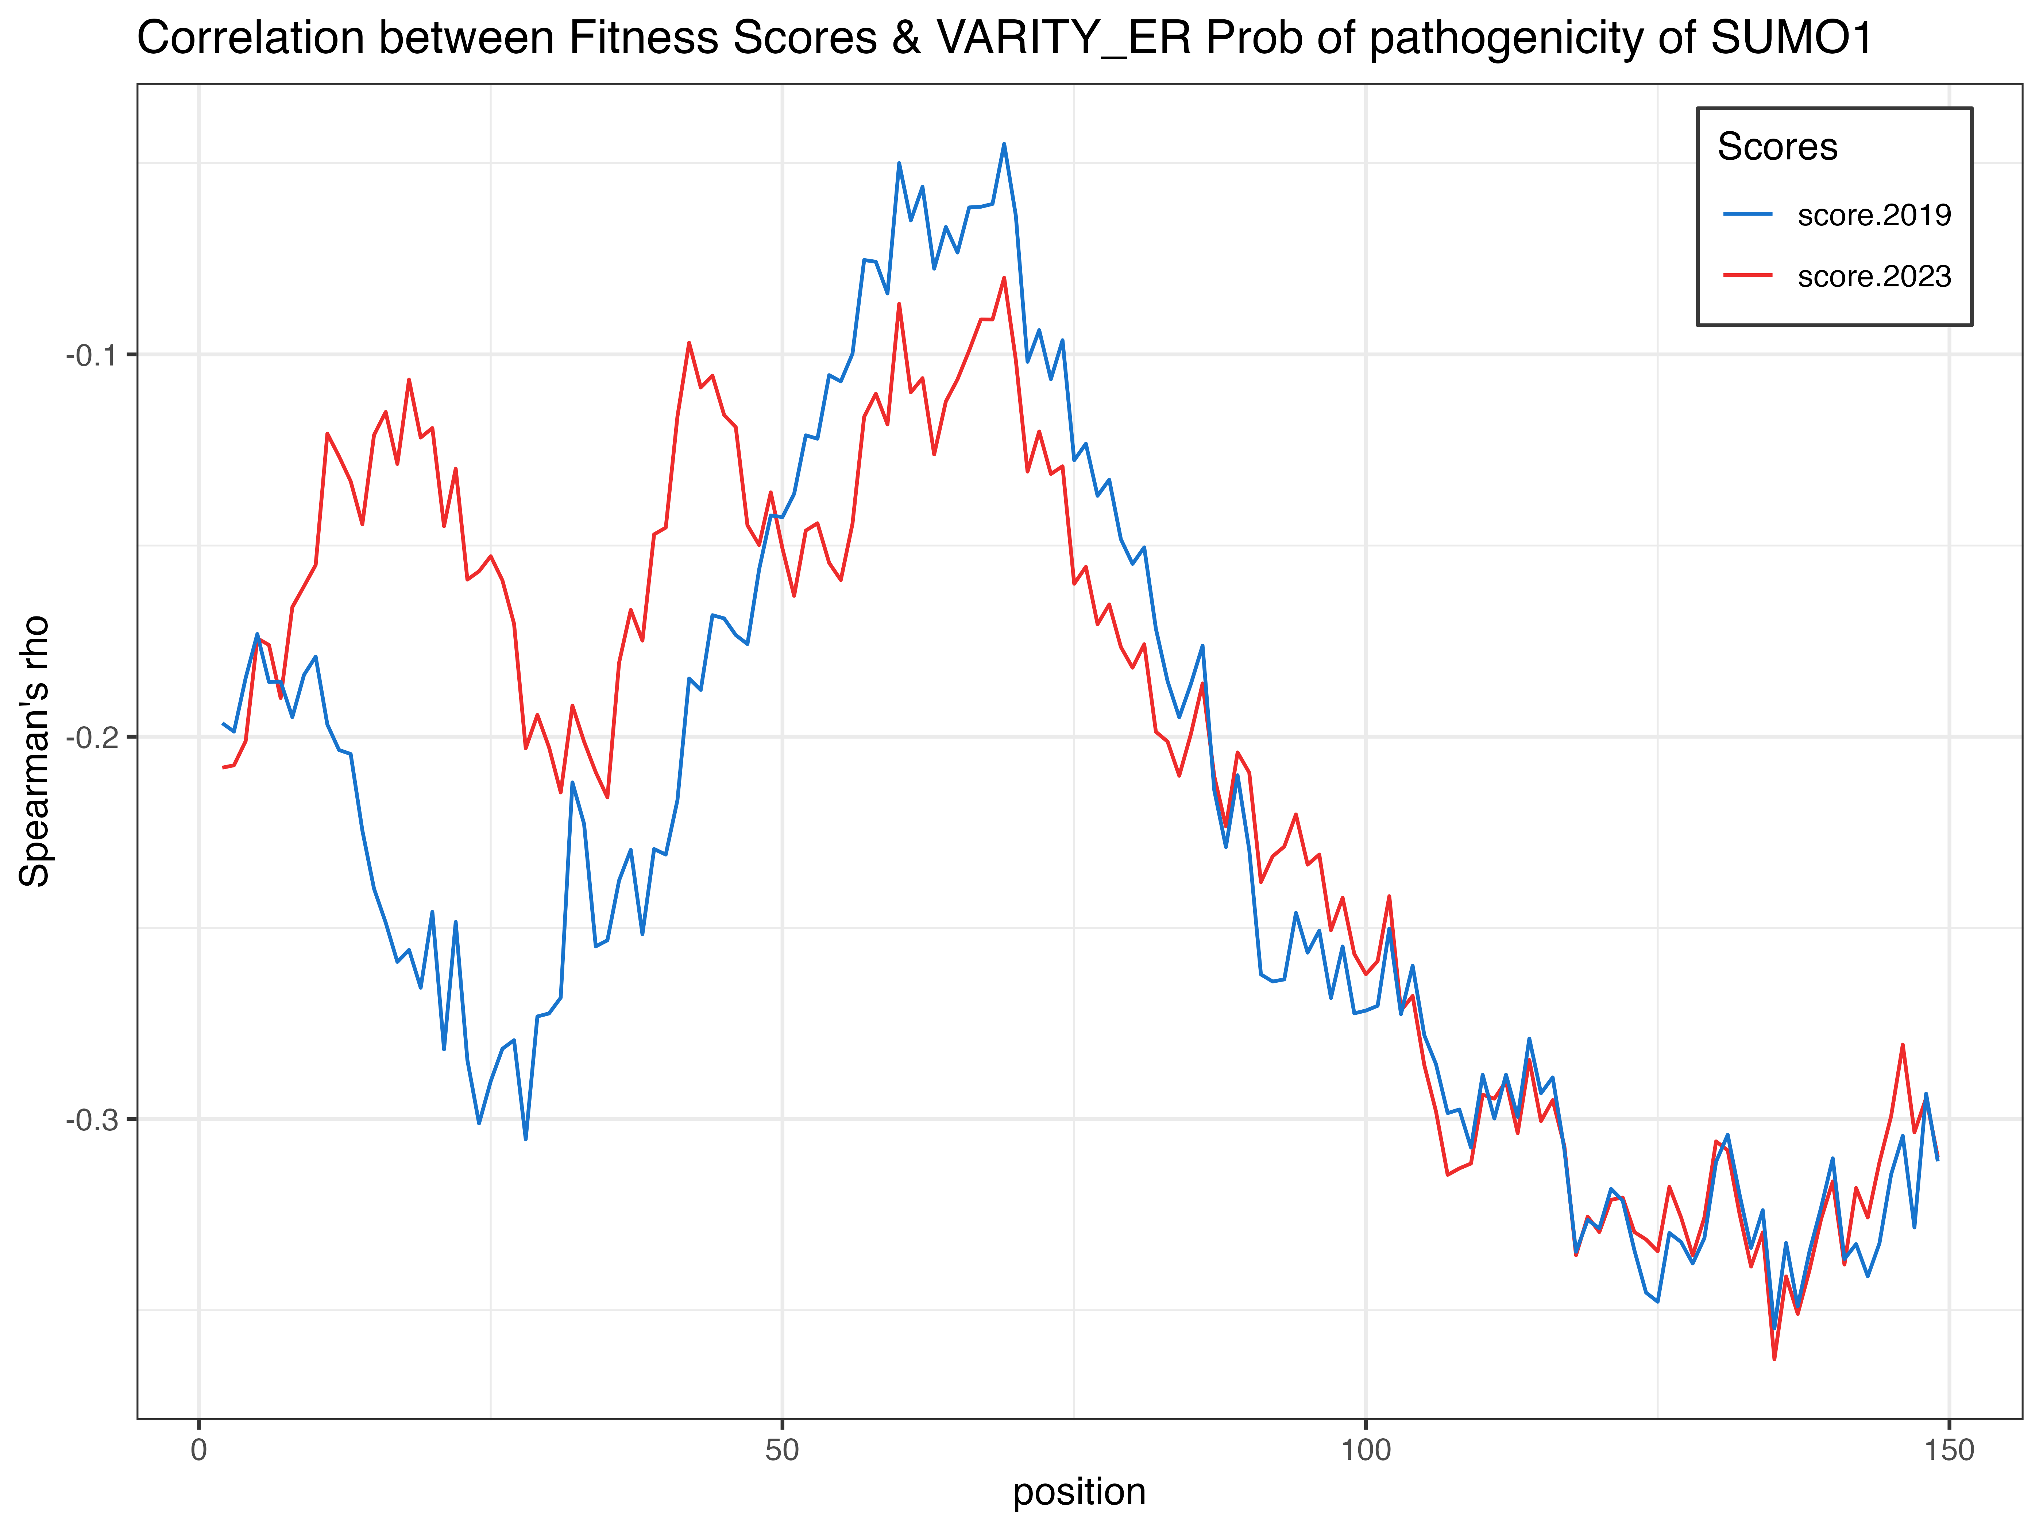
Anti-correlation between fitness score & VARITY scores
Notes:
Scale y to have 0

Slide 24
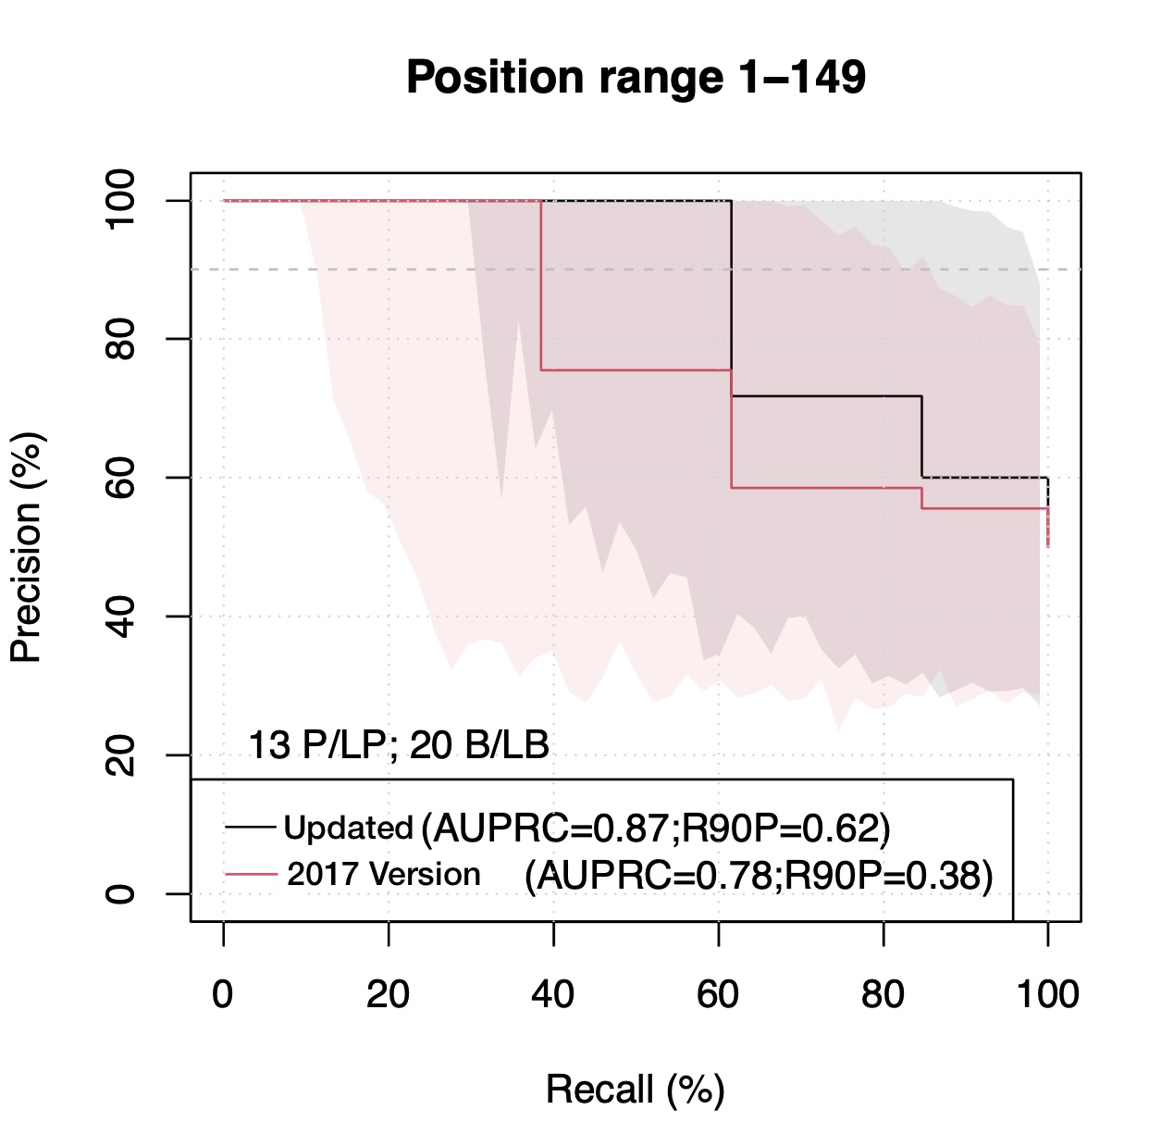
Reference Set: combined reference from GnomAD & ClinVar (CALM1, CALM2, CALM3)
Newer Version Outperformed!
2019
Notes:
Combine calm1 2 3 identical copy

Slide 25
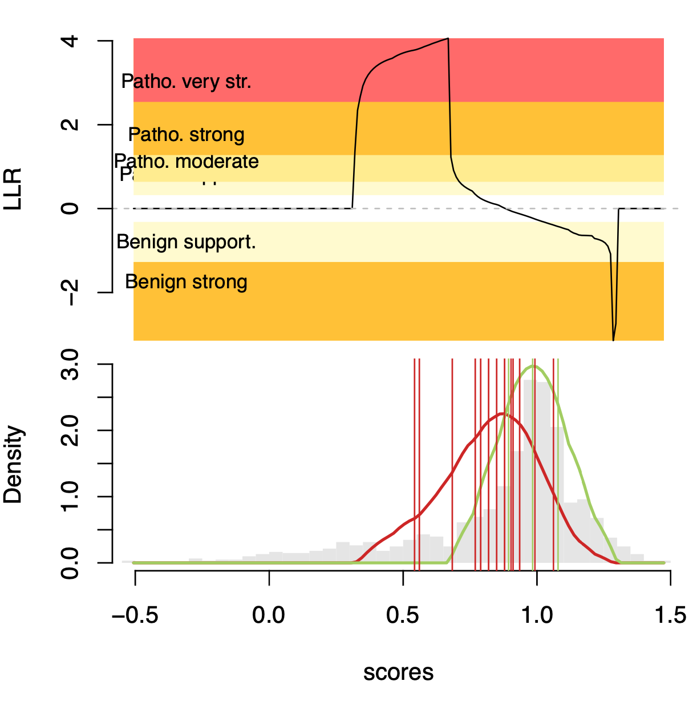
LLR is negative → fitness score range: 0.9 ~ 1.4
(no supported reference data, infer from kernel density estimate)
LLR is positive → fitness score range: 0.3 ~ 0.8
Tendency toward pathogenicity!
Notes:
Benign – not supported ref data – shape infer from kde add grey box

Slide 26
CALM1 Conclusion
The New pipelines performed better than old pipelines
The New pipelines used more info on generate the error estimates -> Accurate Error Estimation

Slide 27
MTHFR in A222V Background
QC Results
PRC
LLR of Pathogenicity
Conclusion

Slide 28
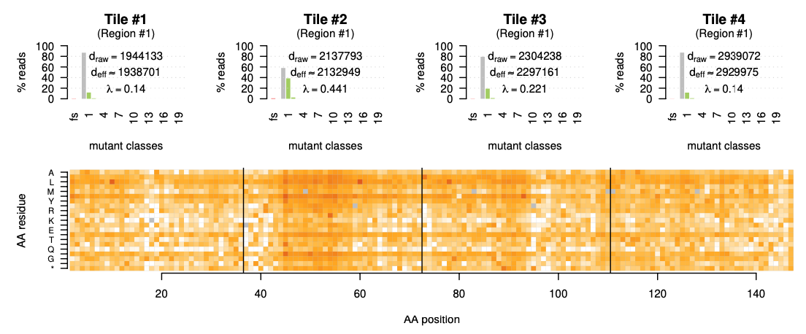
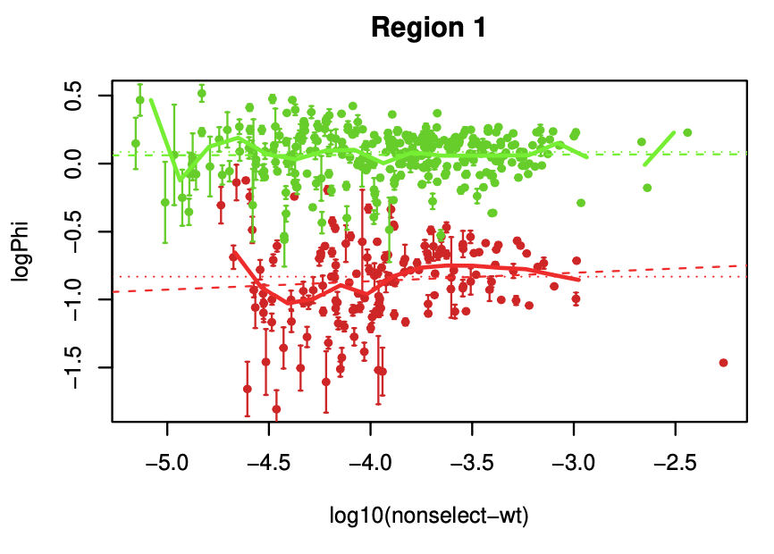
~ 2/3 of Variants were filtered out
~ -4.3
Minimum read count:
$${10}^{6}×{10}^{−4.3} ≈100$$

Slide 29
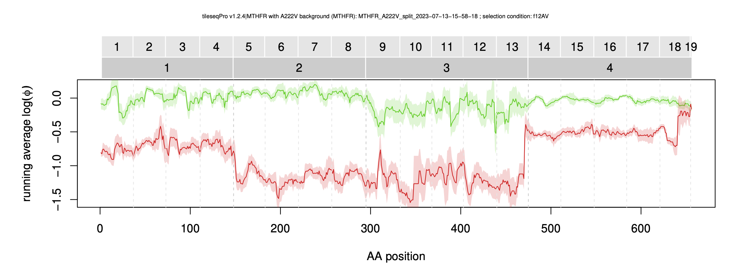
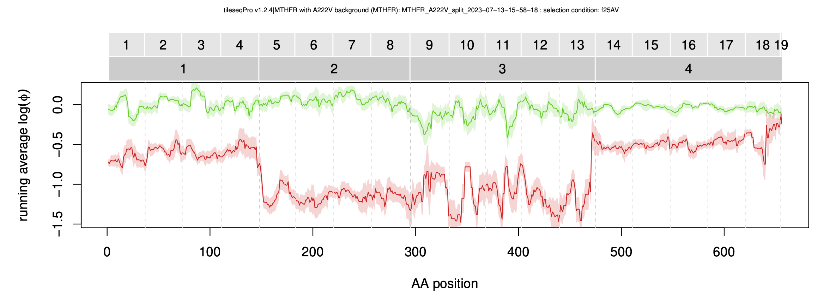
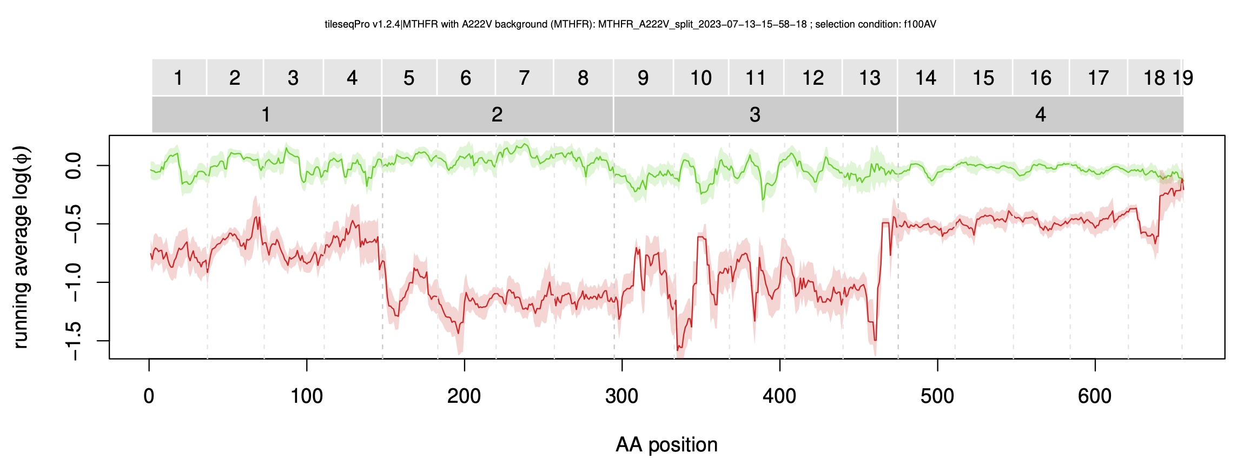
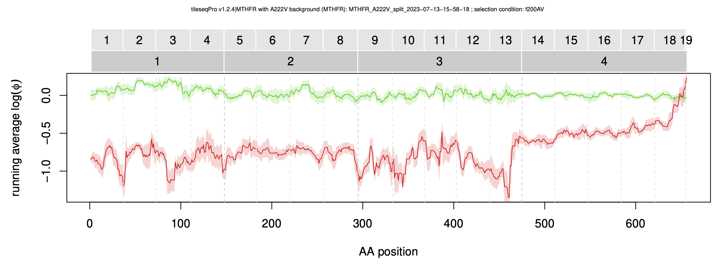
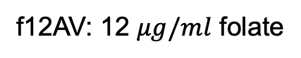
Good Separation Except at the End of Region 4
f12AV: 12 $μg/ml$ folate
f25AV: 25 $μg/ml$ folate
f100AV: 100 $μg/ml$ folate
f200AV: 200 $μg/ml$ folate
Minimum read count: 50
Notes:
Close to end --

Slide 30
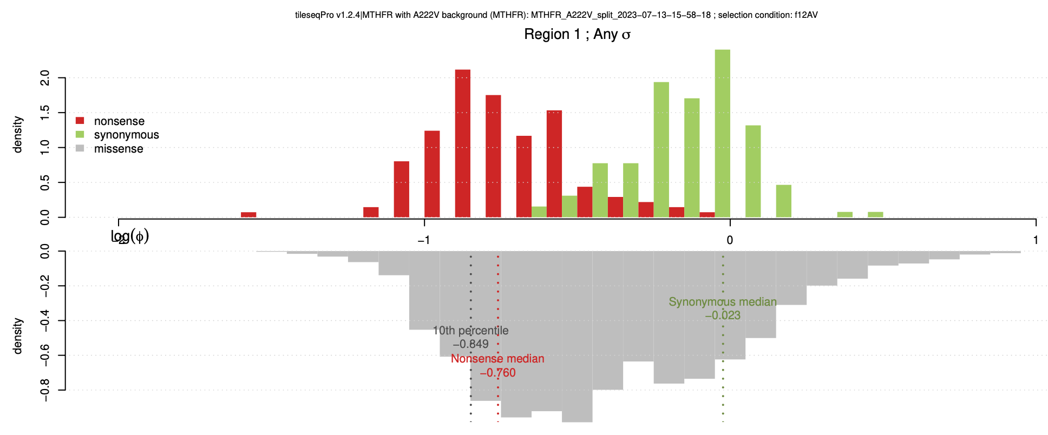
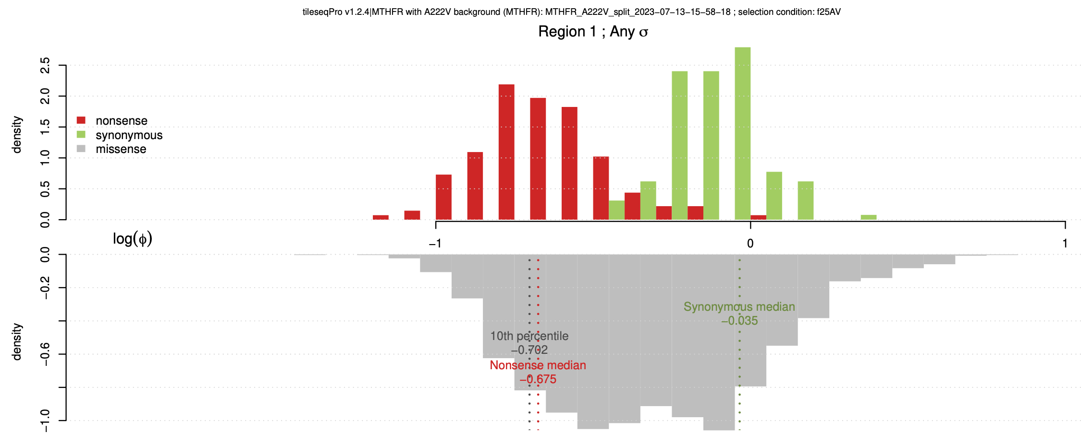
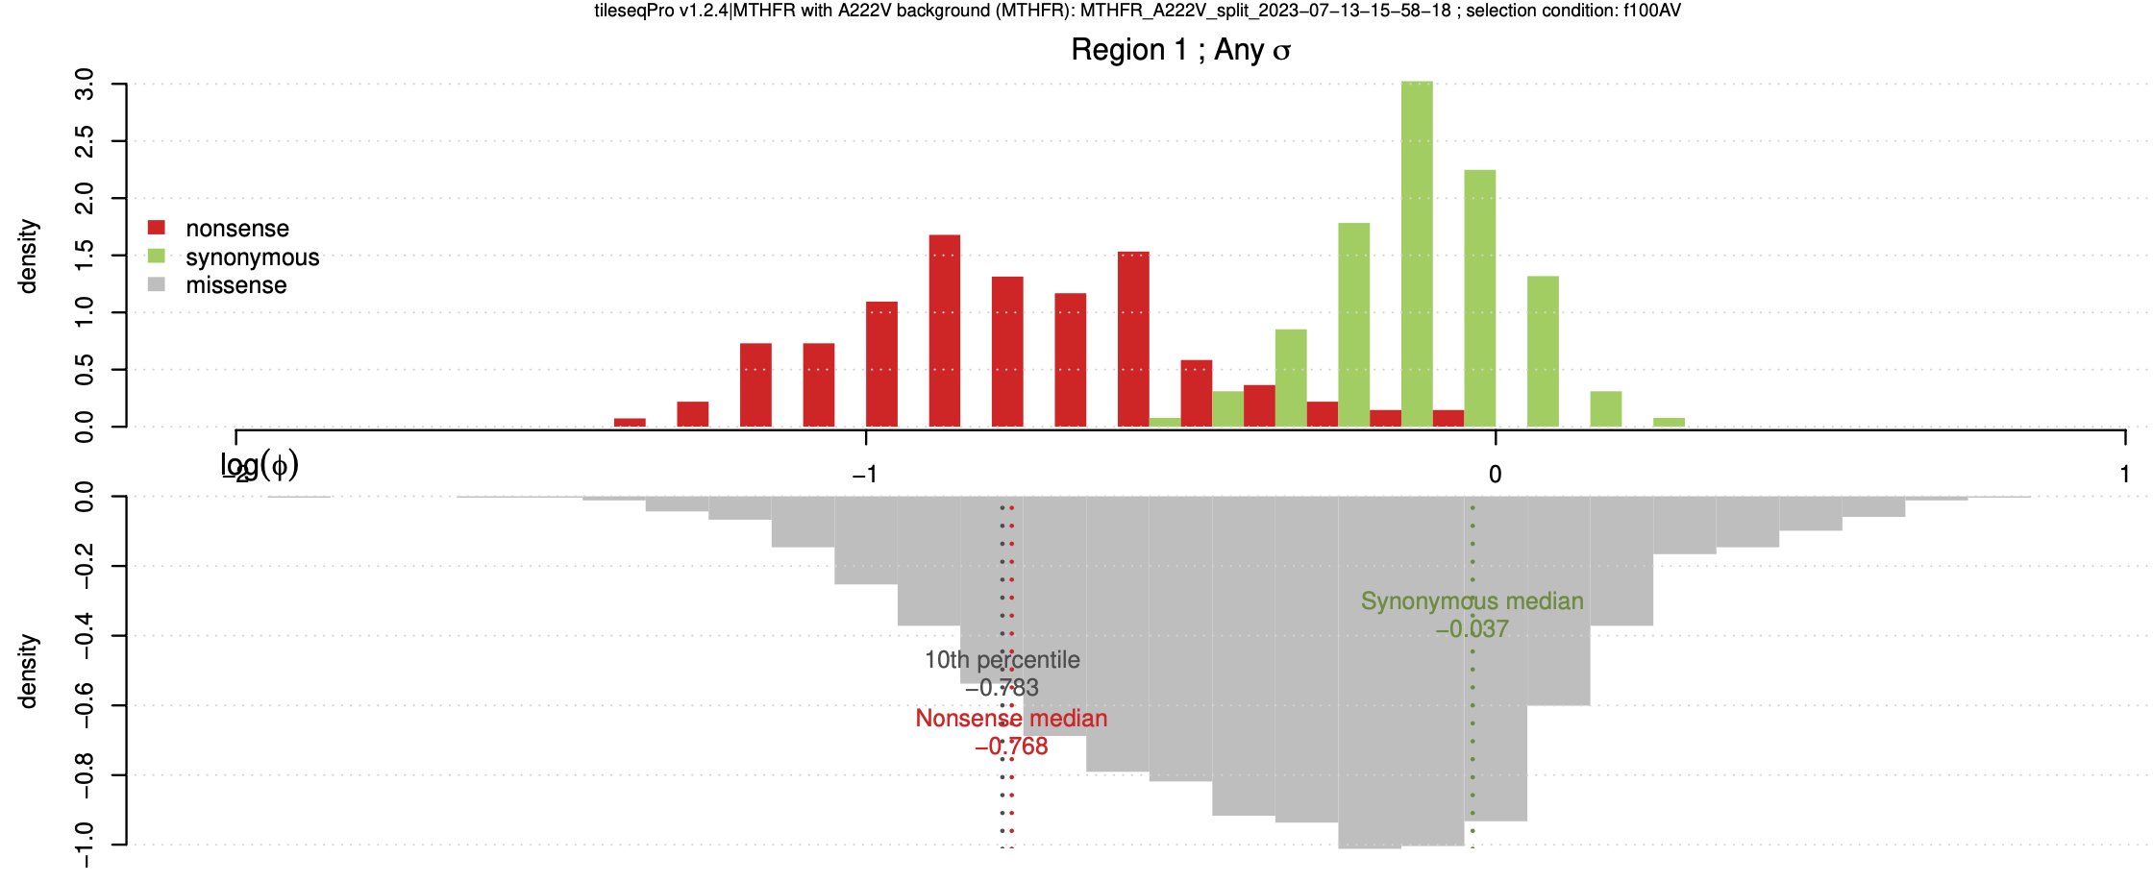
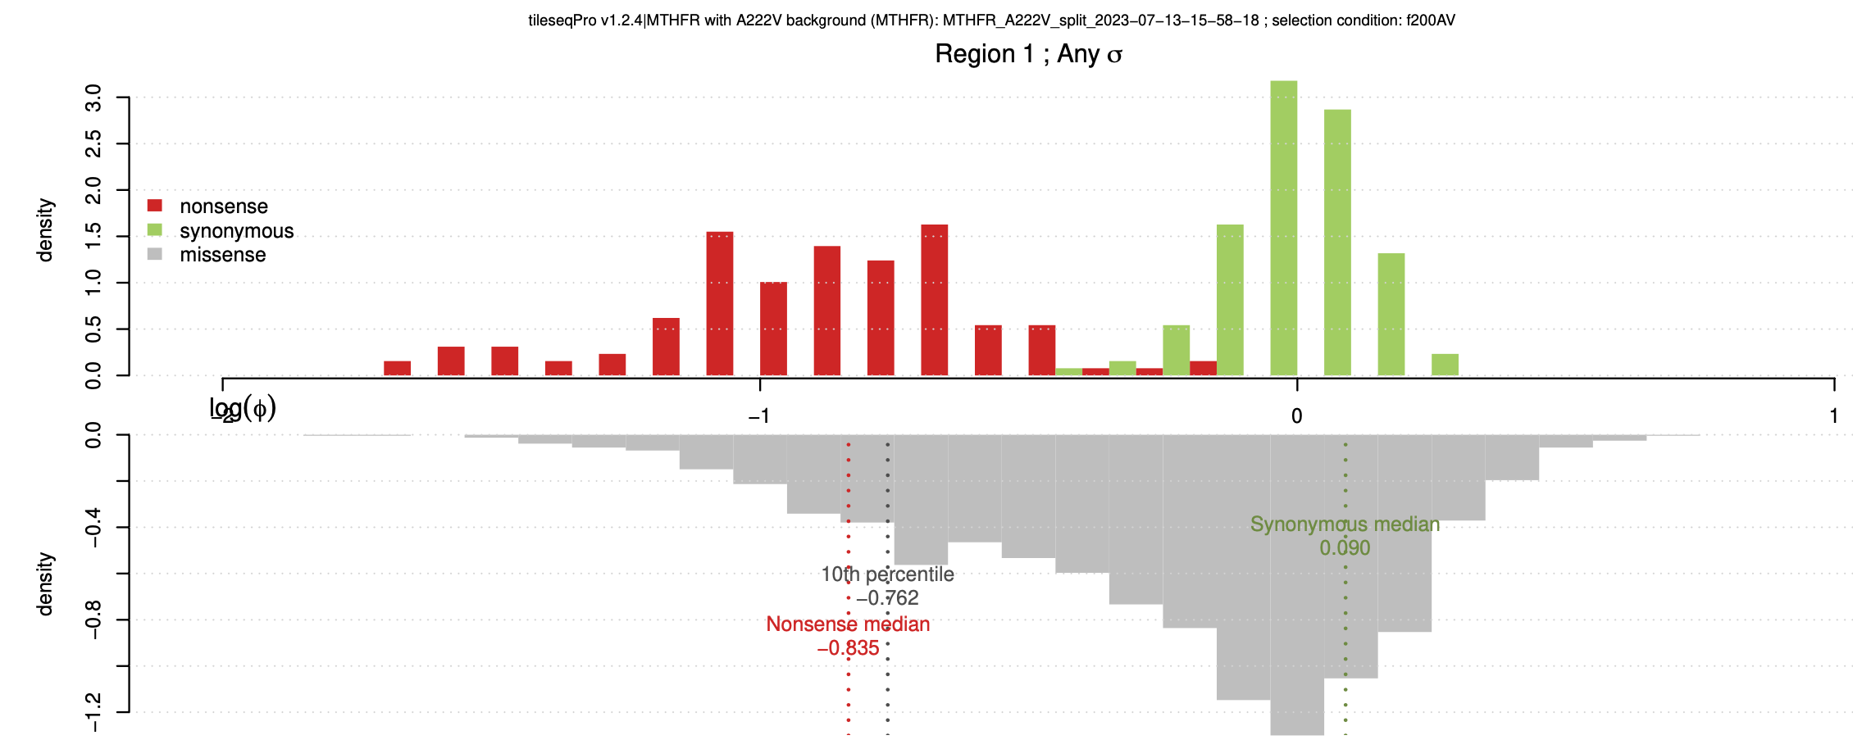
MTHFR: Region 1
f12AV: 12 $μg/ml$ folate
f25AV: 25 $μg/ml$ folate
f100AV: 100 $μg/ml$ folate
f200AV: 200 $μg/ml$ folate

Slide 31
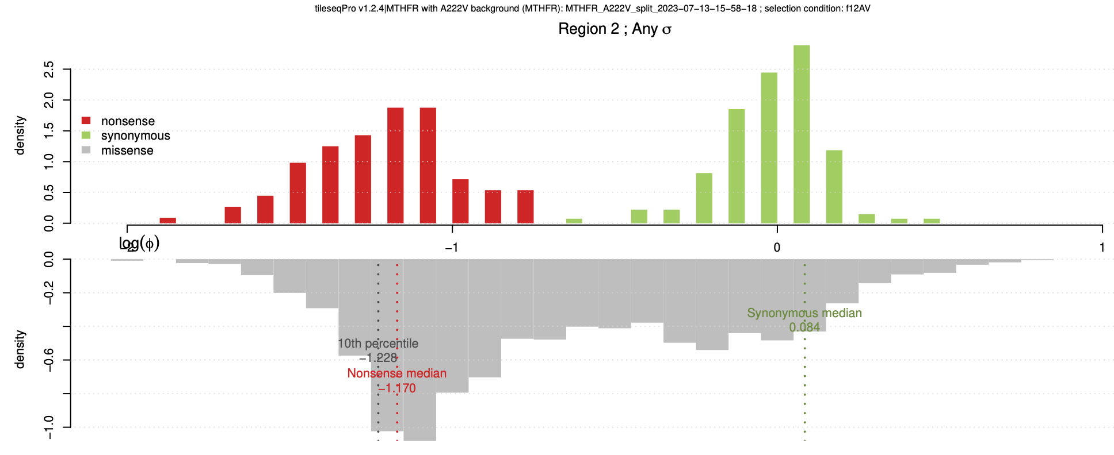
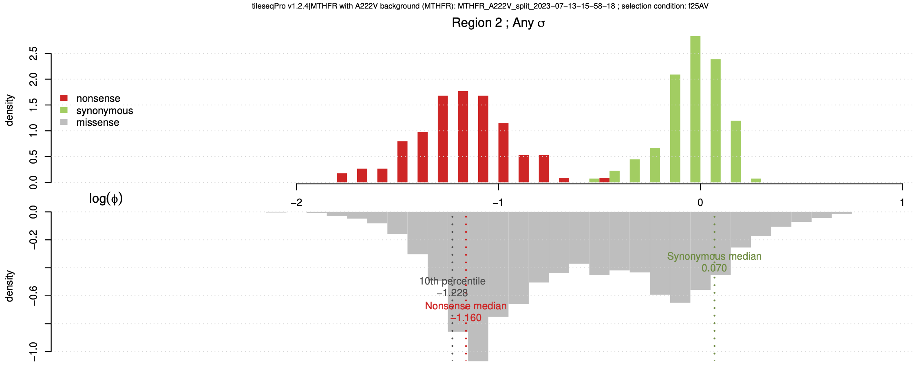
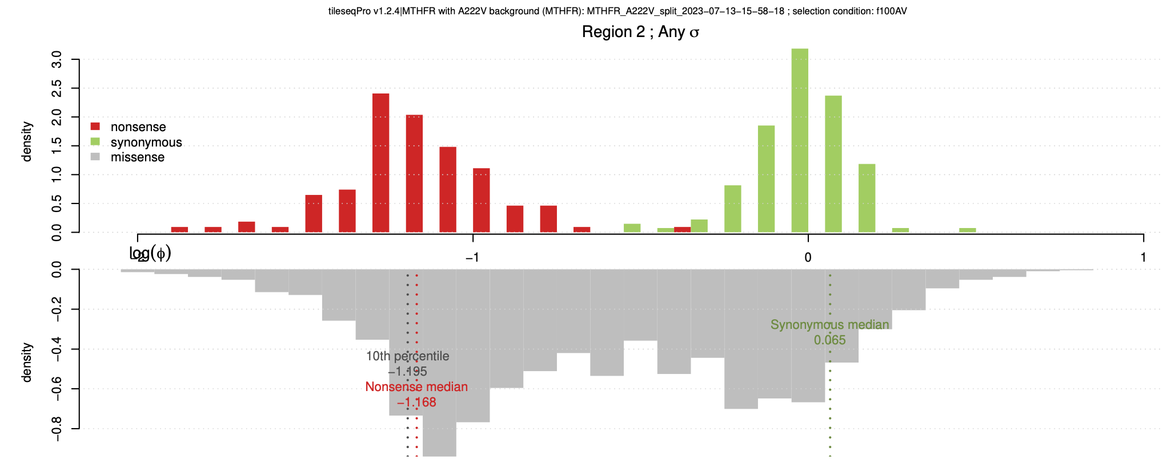
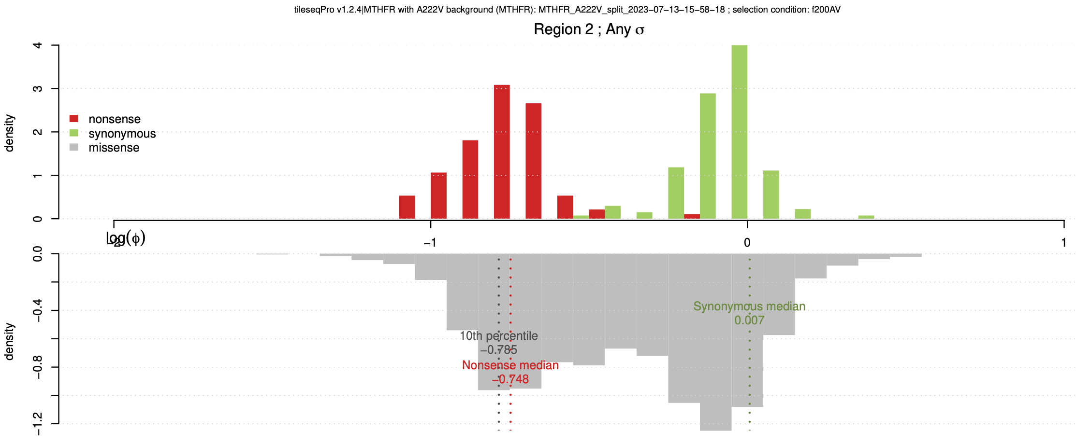
MTHFR: Region 2
f12AV: 12 $μg/ml$ folate
f25AV: 25 $μg/ml$ folate
f100AV: 100 $μg/ml$ folate
f200AV: 200 $μg/ml$ folate

Slide 32
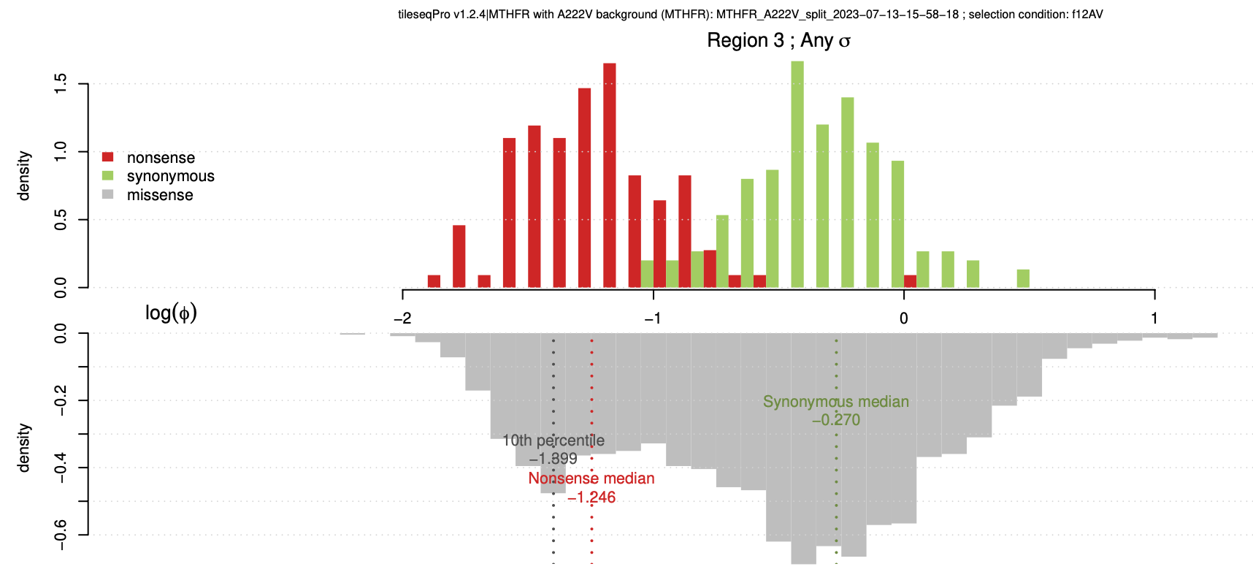
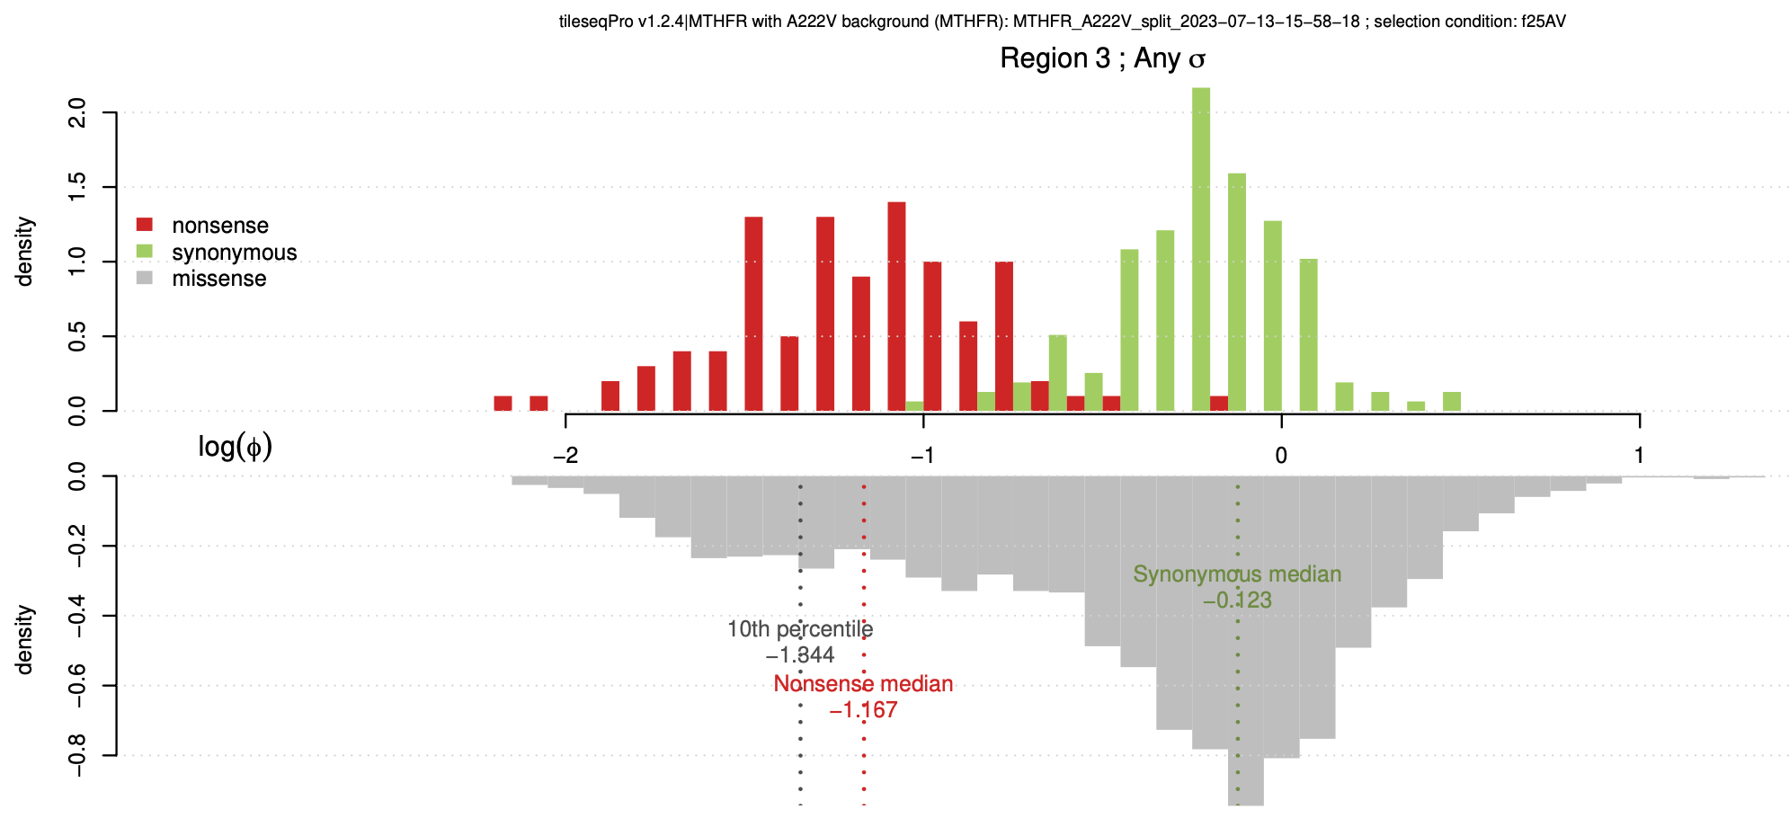
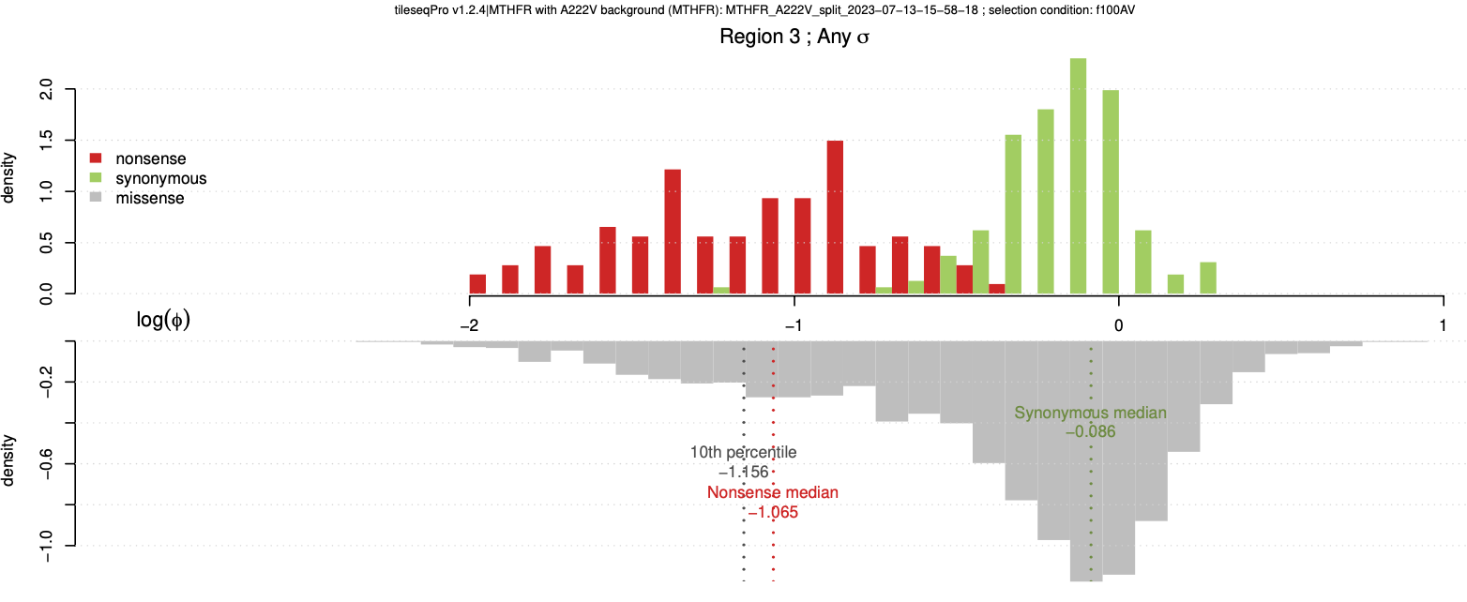
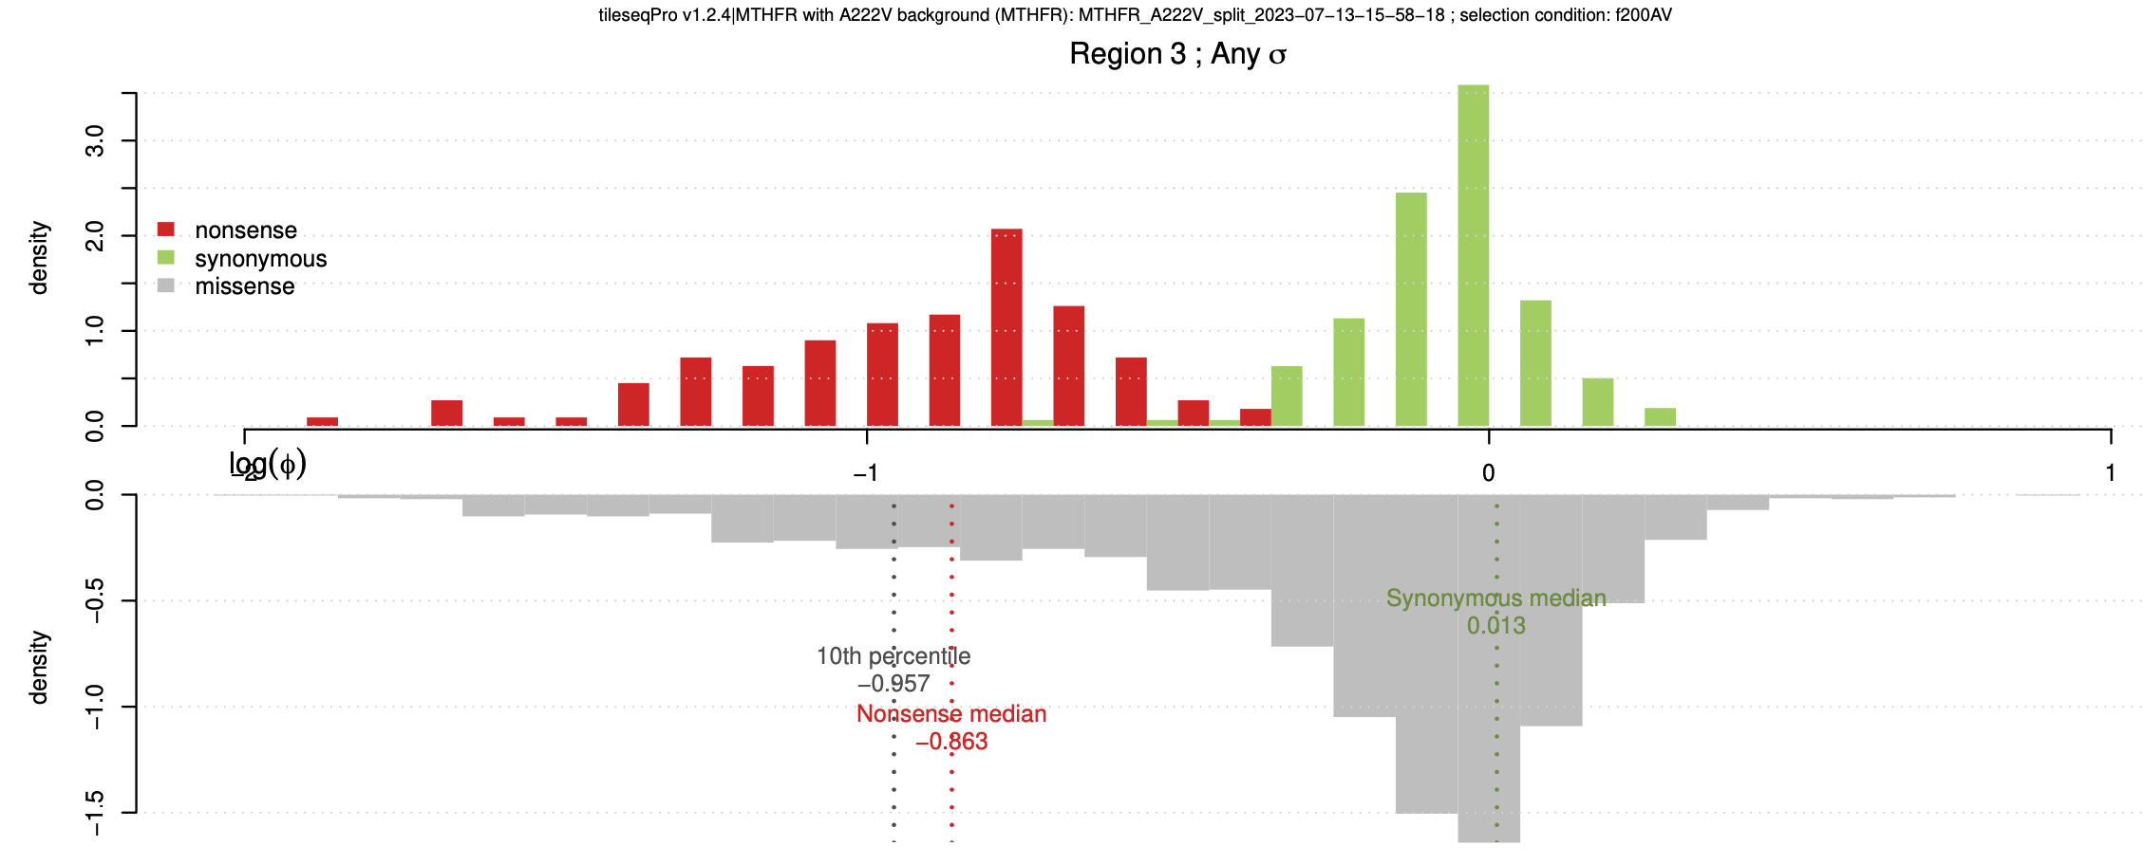
MTHFR: Region 3
f12AV: 12 $μg/ml$ folate
f25AV: 25 $μg/ml$ folate
f100AV: 100 $μg/ml$ folate
f200AV: 200 $μg/ml$ folate
Notes:
Assay works better for f200AV

Slide 33
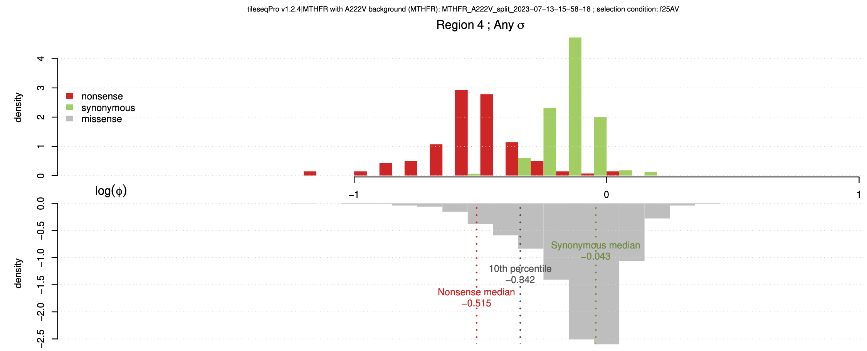
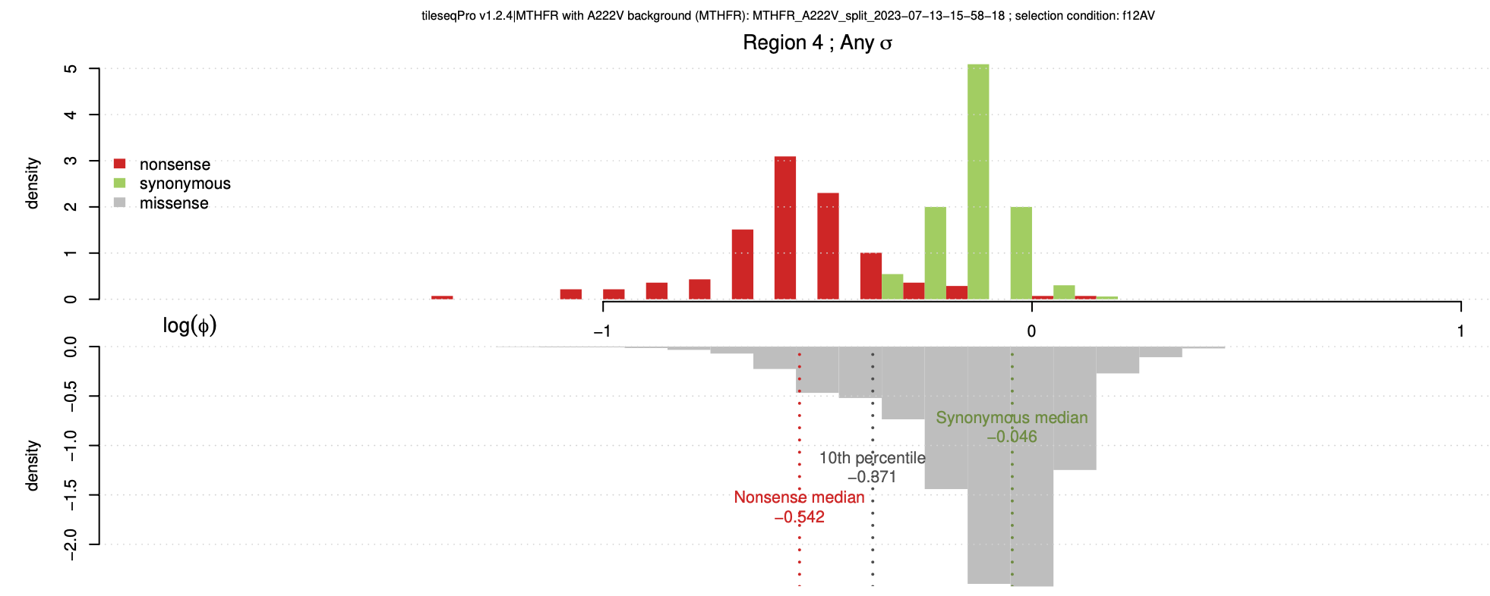
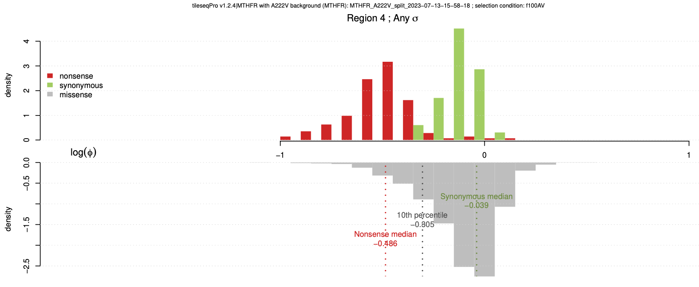
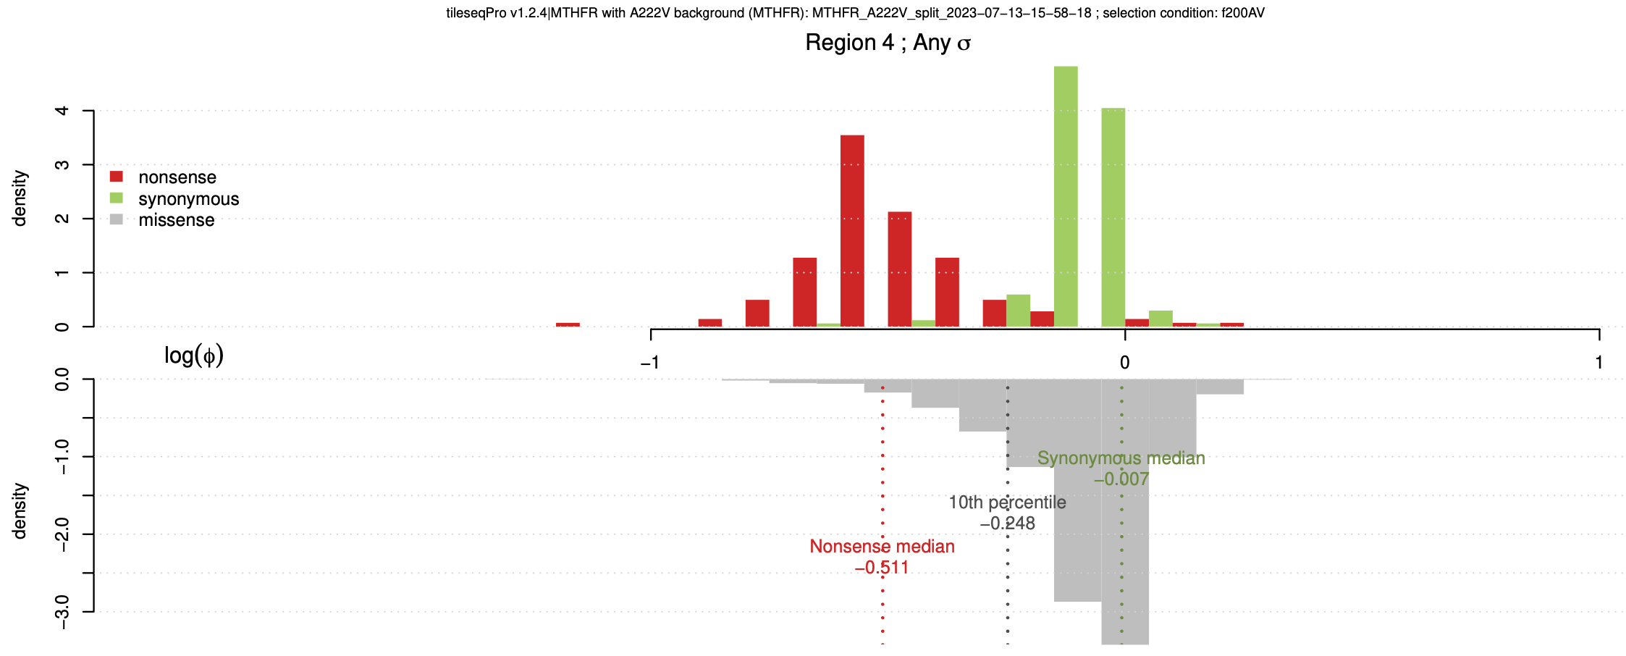
MTHFR: Region 4
f12AV: 12 $μg/ml$ folate
f25AV: 25 $μg/ml$ folate
f100AV: 100 $μg/ml$ folate
f200AV: 200 $μg/ml$ folate

Slide 34
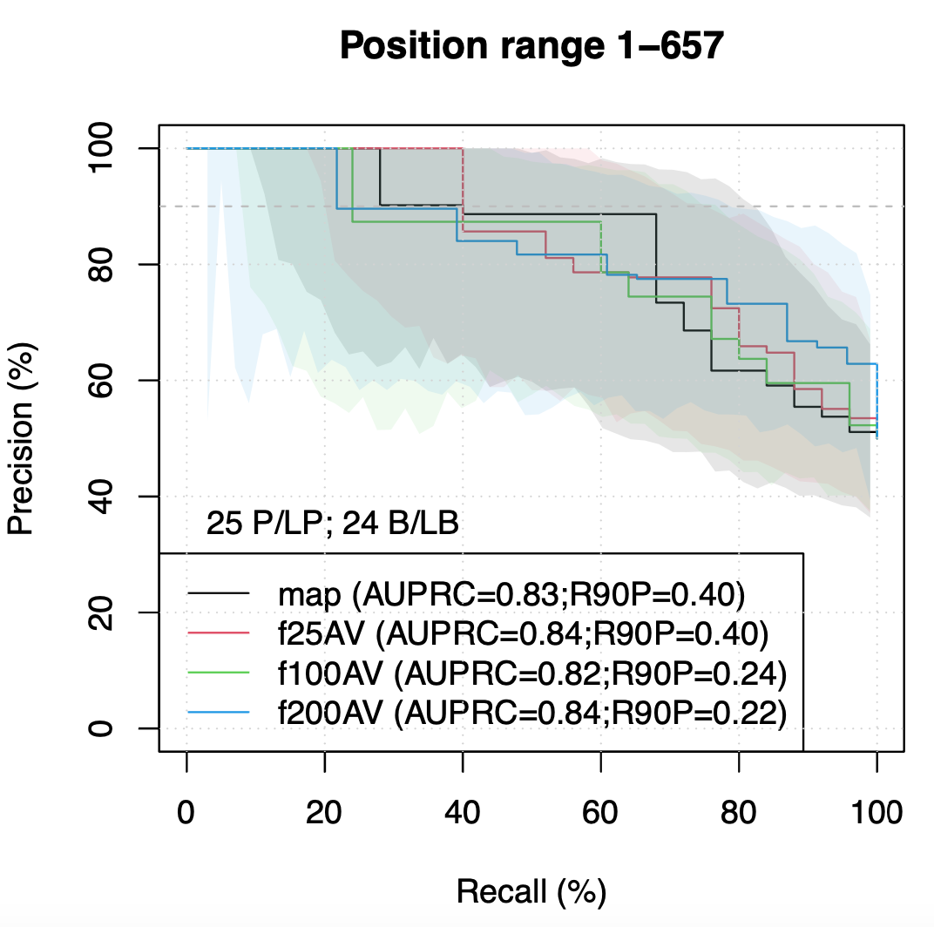
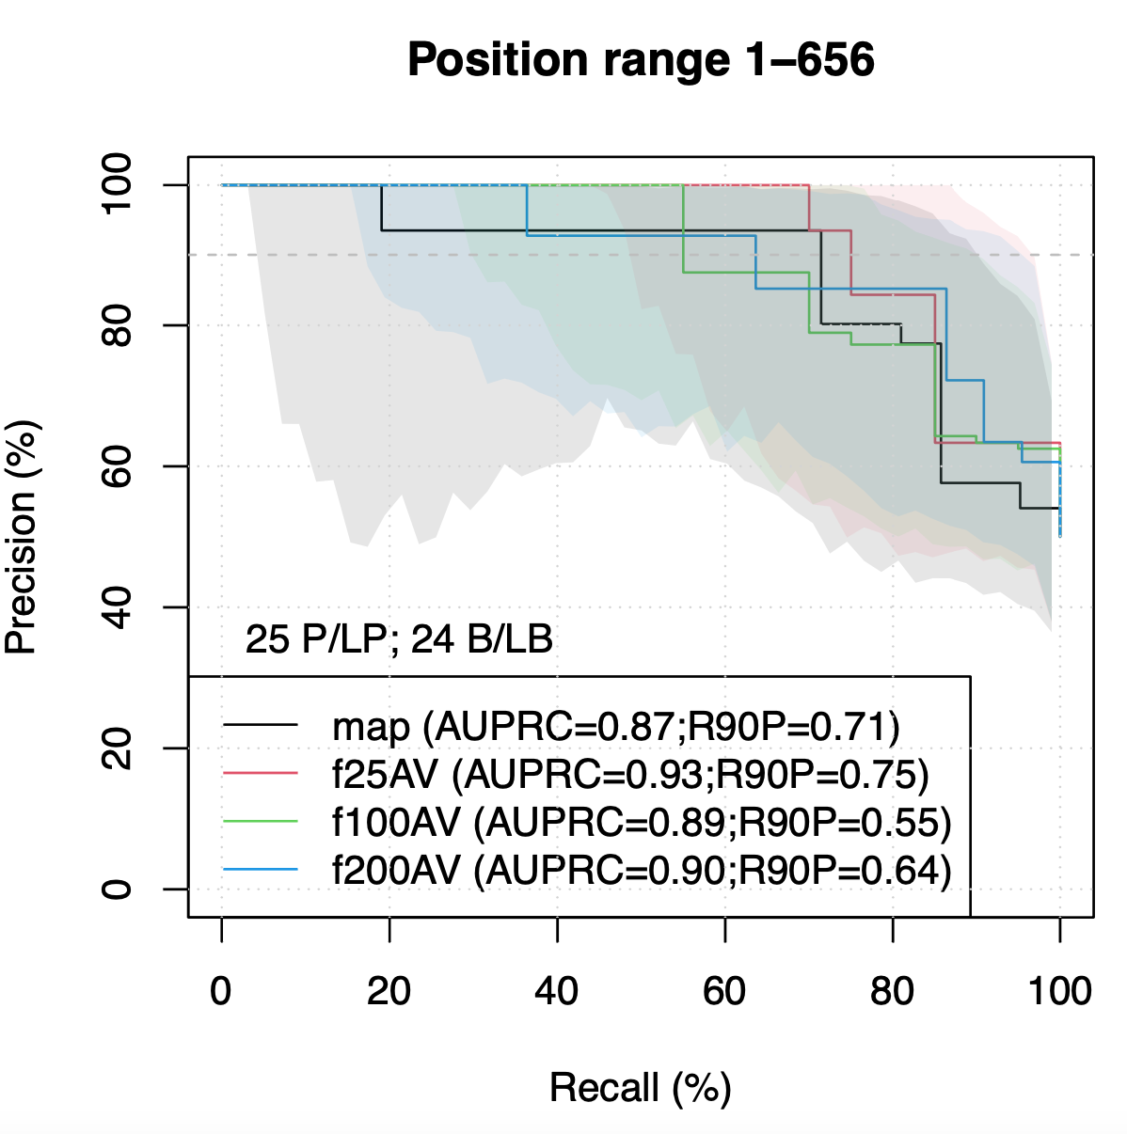
Newer Version Outperformed
Newer version
Reference Set: Manually curated reference set from the paper
Notes:
New version – better performance

Slide 35
MTHFR: LLR

Slide 36
MTHFR: LLR

Slide 37
SUMO1
CALM1
Good candidate for imputation!
Notes:
Sumo – first 20 disorder region wt 1
Good candidate for imputation

Slide 38
MTHFR in A222V Background
f12AV
f25AV
f100AV
f200AV

Slide 39
Discussion & Future goals
SUMO1 – tie
CALM1 – newer pipeline looks better
Compile benchmark reference sets
Working on more genes later
Write a wiki article for these genes

Slide 40
Thank you!

